Slide 1
— State Framework for Lived Experience (Peer) Workforce Development - Australia, Queensland
Dr. Louise Byrne, RMIT
Dr. Lena Wang, RMIT
Helena Roennfeldt, RMIT
Dr. Melissa Chapman, RMIT

Slide 3
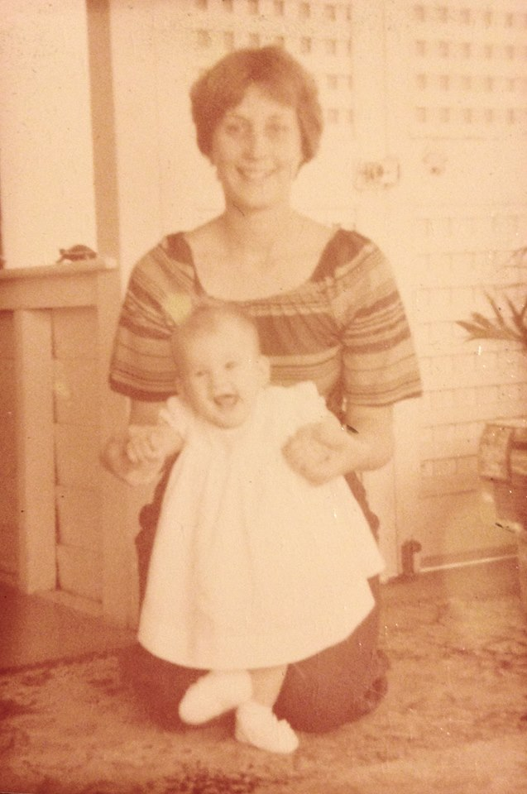
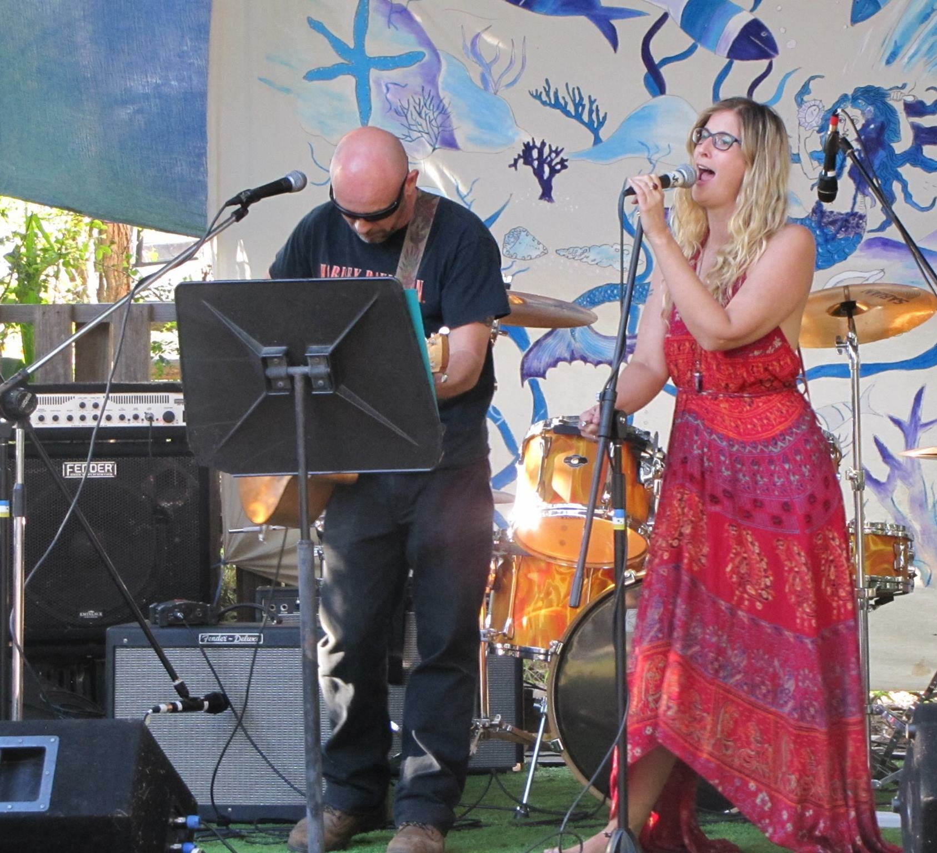
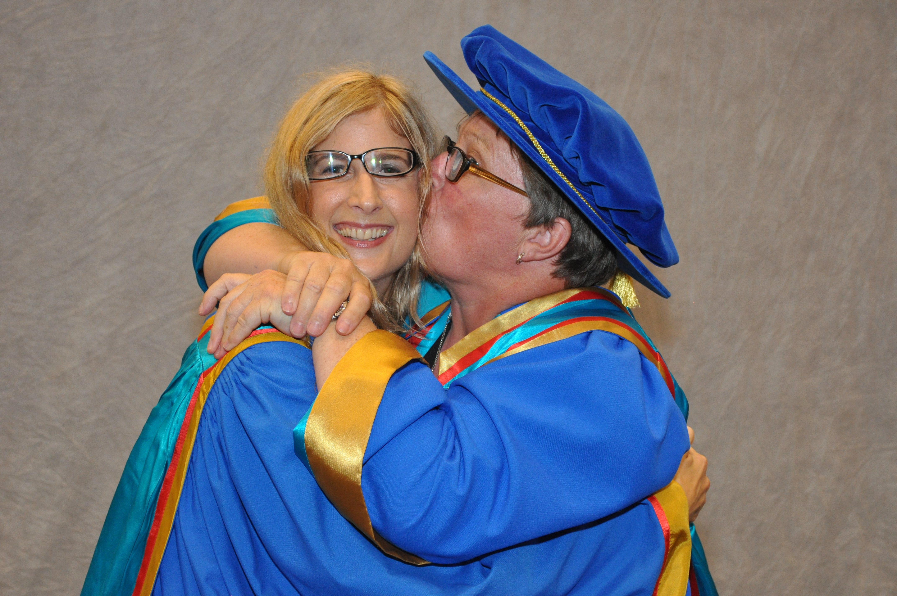
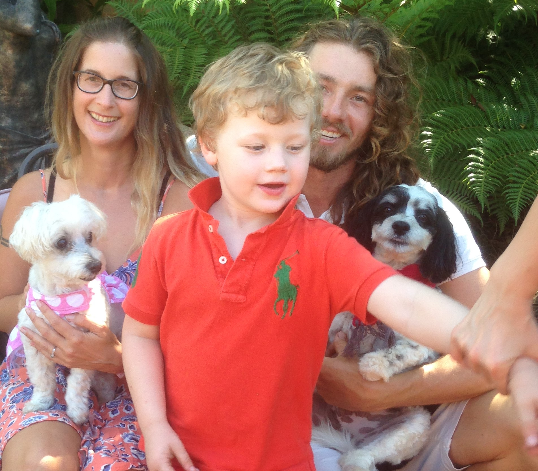
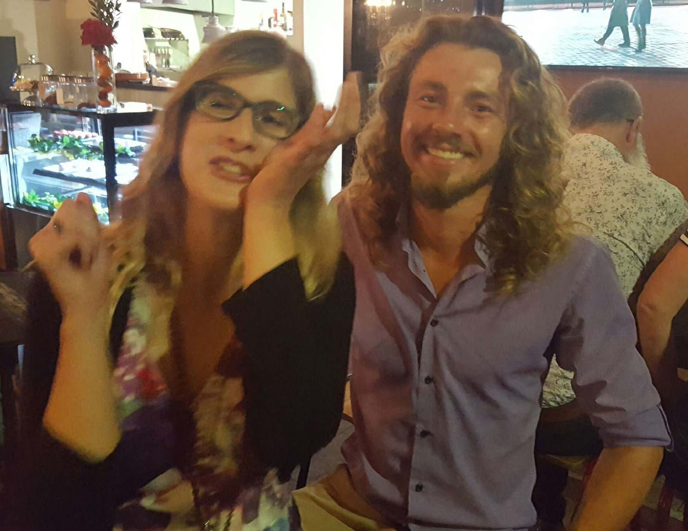
— Who am I?

Slide 4
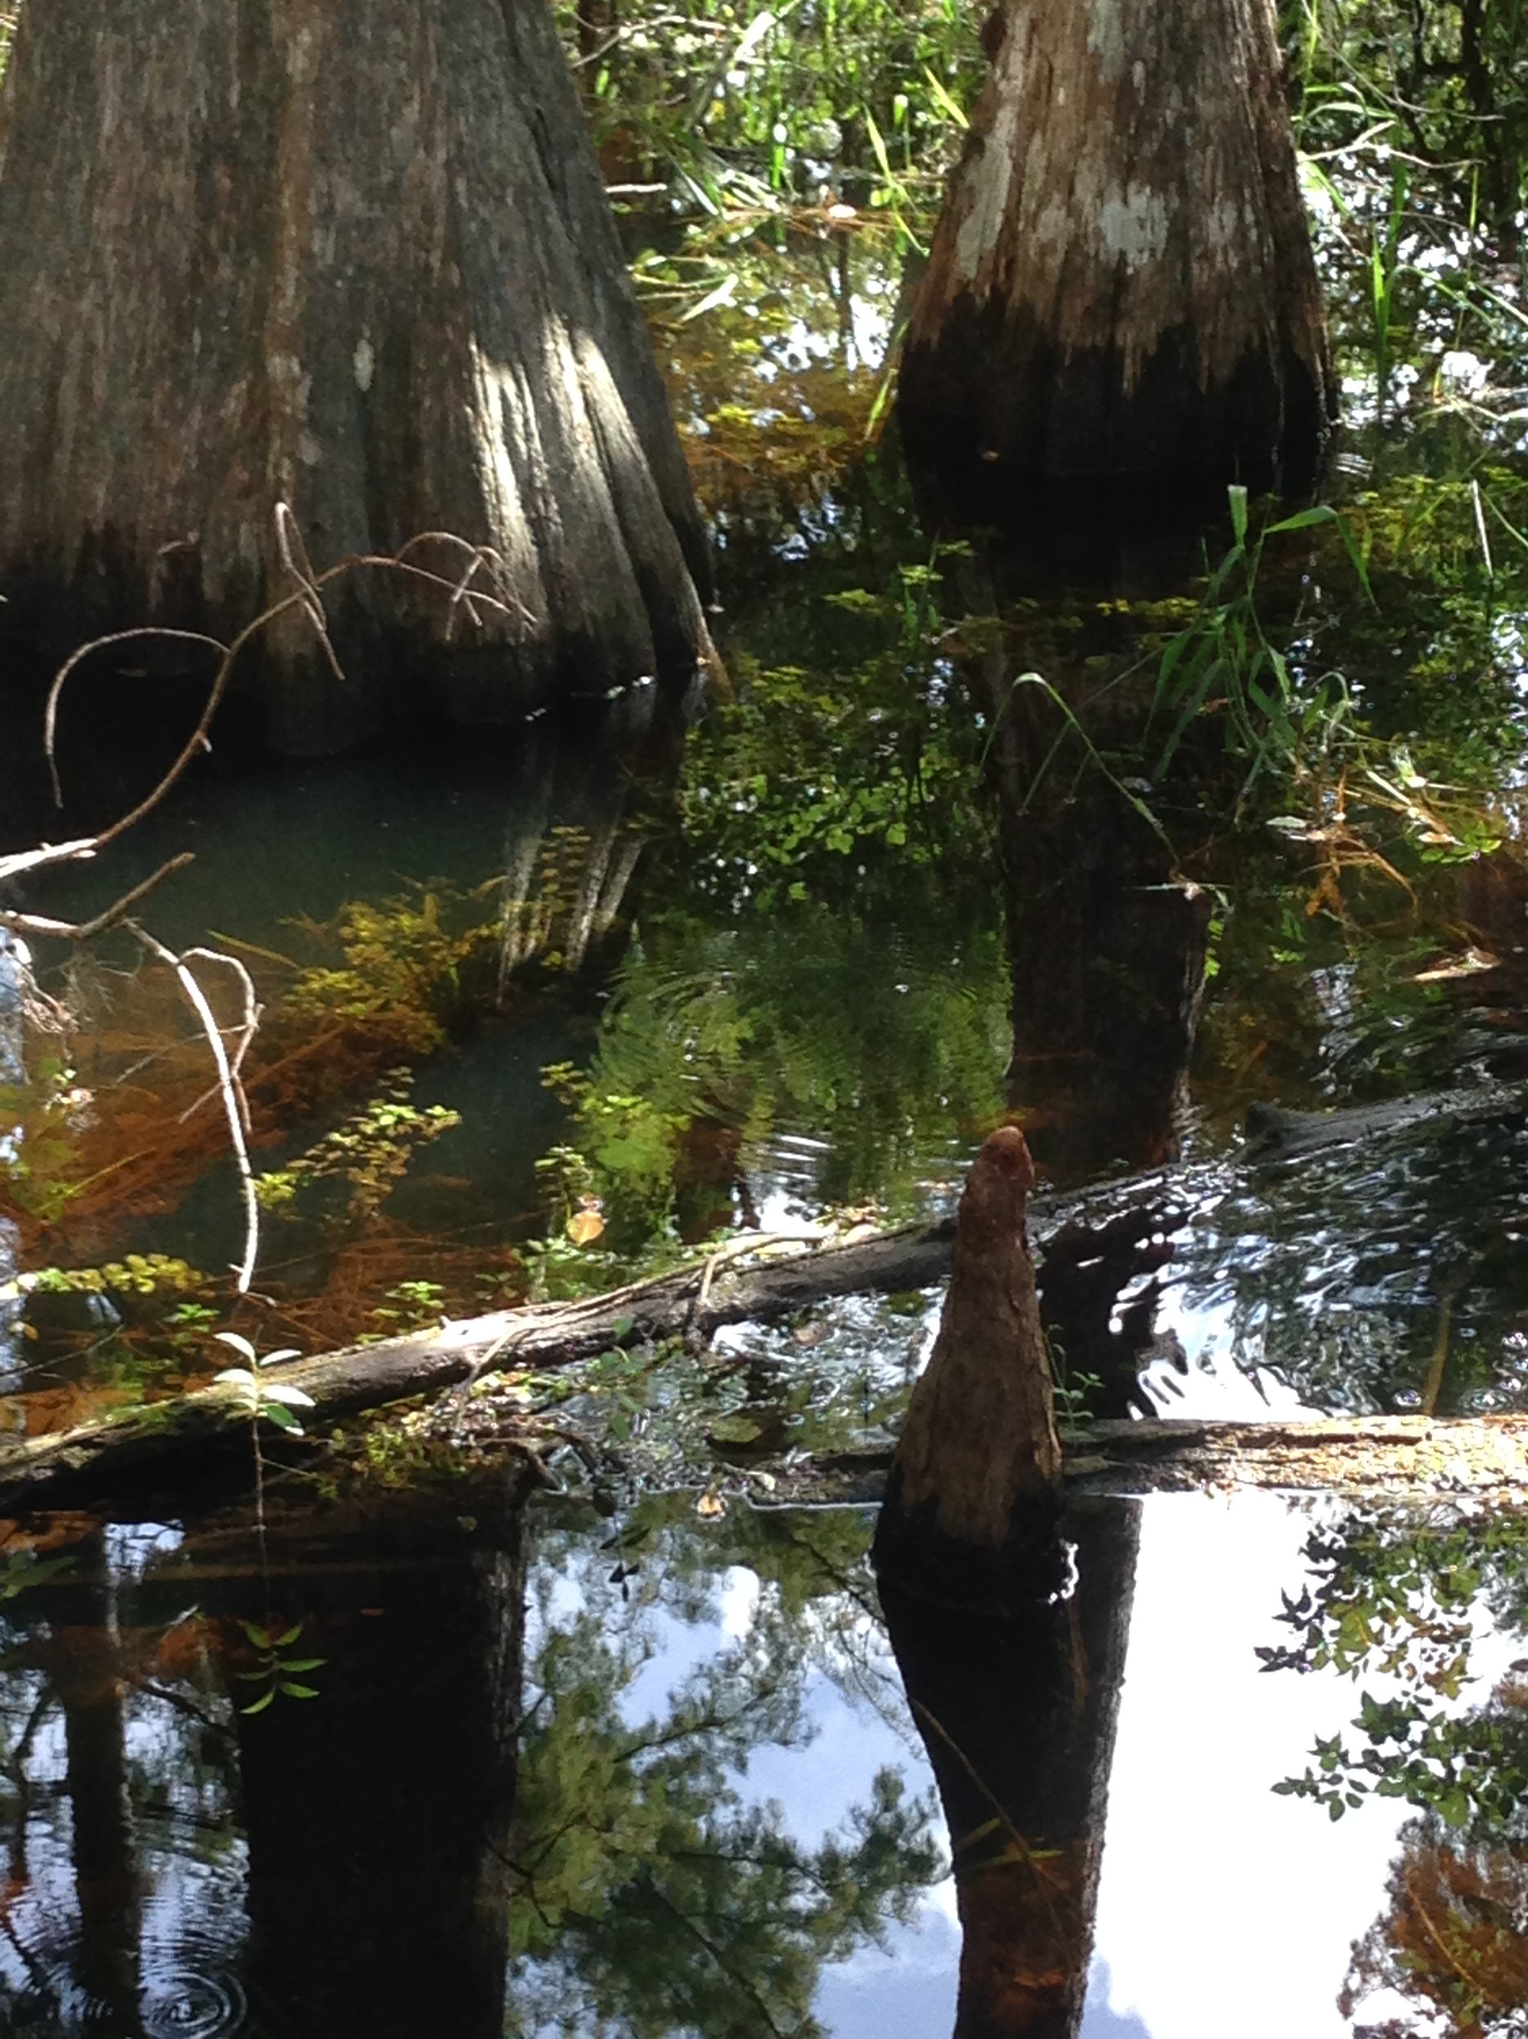
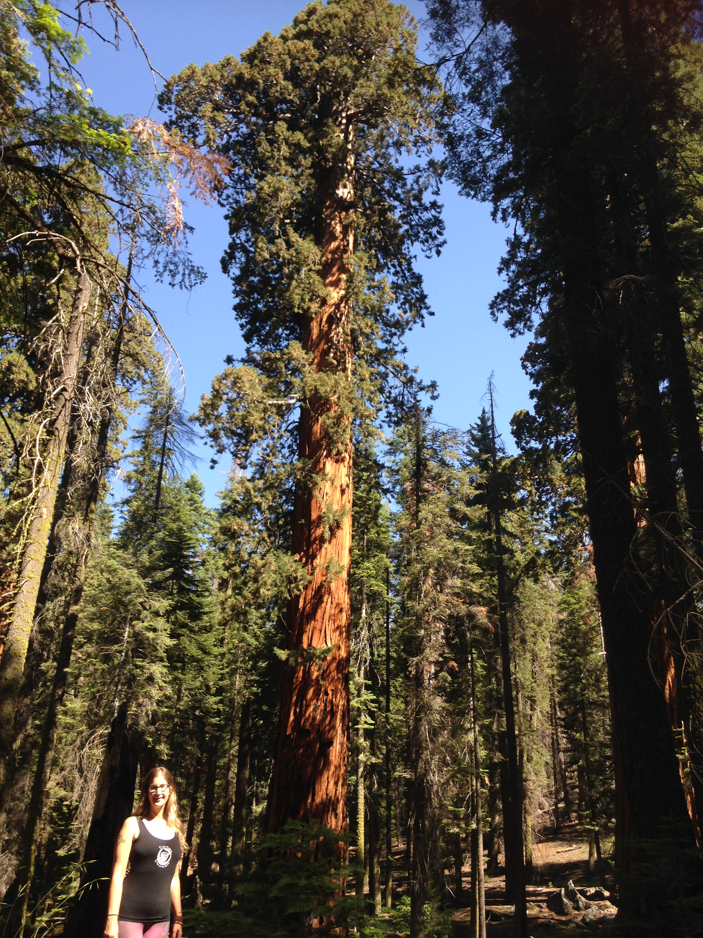
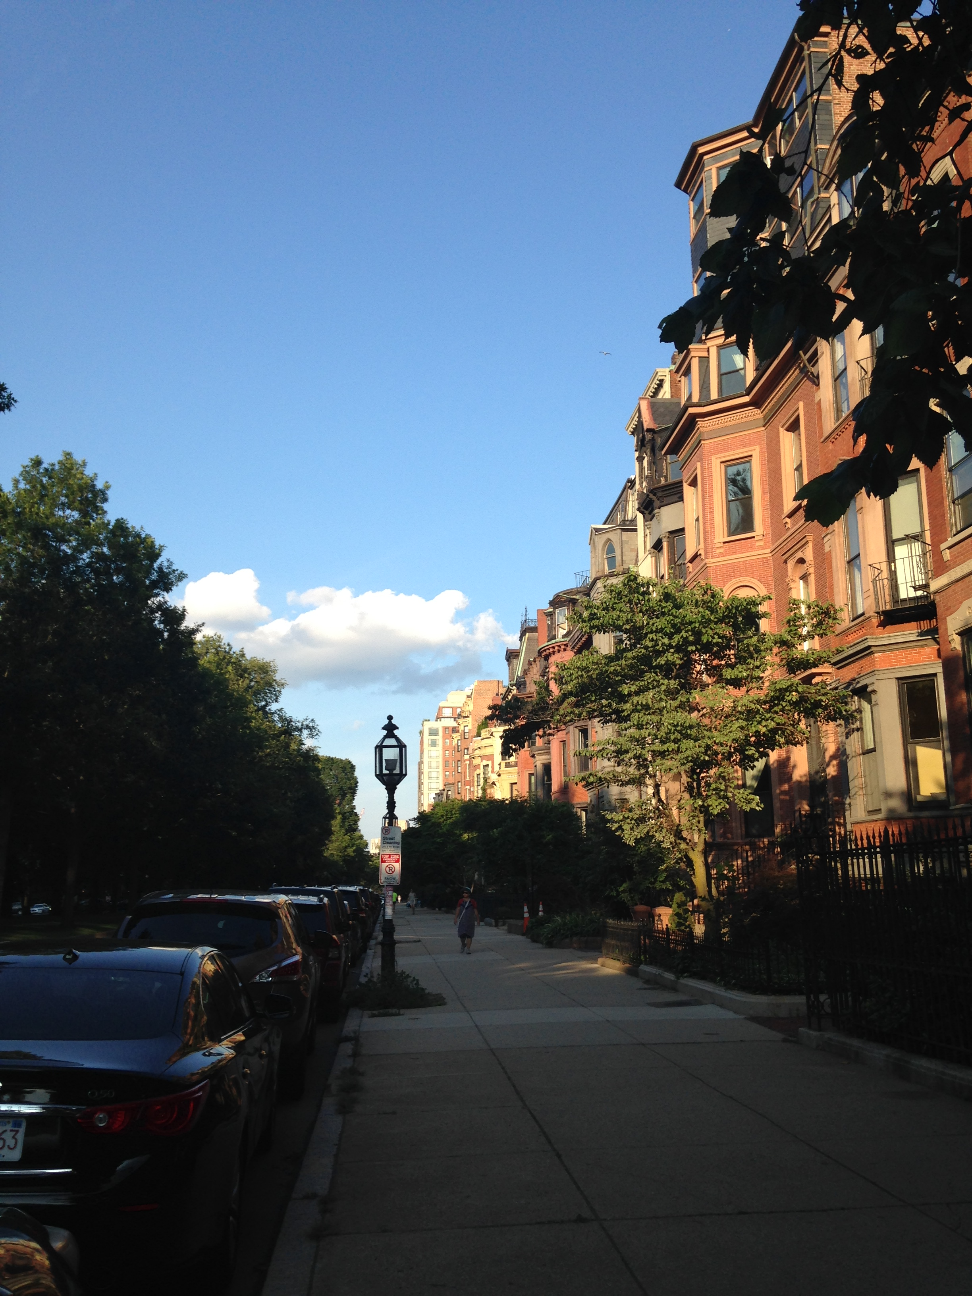
132 Participants 8 individual interviews 124 focus group attendees 14 focus groups
Organisations and Participants
5 Organisations: Rural/regional, Metropolitan and mixed districts. Northern, Southern States, West and East Coast
47 traditional management roles (not peer designated)
38 peer designated (not management)
32 traditional roles (not peer designated)
7 peer management designated positions
5 other

Slide 5
How People Described Themselves
1 person identified as Native Hawaiian/Pacific Islander 2 people identified as Native American 6 people identified as Hispanic 7 people identified as Asian 10 people identified as being Multiracial 15 people identified as African American/Black 88 people identified as European descended/White
1 Transgender
3 Don’t wish to identify
41 Male
84 Female

Slide 6
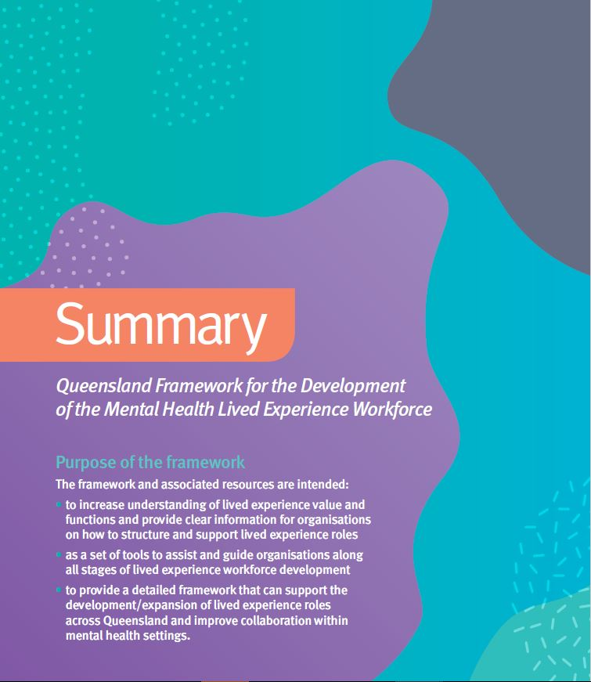
https://www.qmhc.qld.gov.au/engage-enable/lived-experience-led-reform/peer-workforce

Slide 7
Participation and Engagement Strategies
Steering Committee
Advisory Group
Cultural and Diversity Advisors
Focus Groups
Survey

Slide 8
Relationship between lived experience and mental health sector broadly
Shared understanding and knowledge of lived experience roles
Supervisory support
Organisational support, commitment and workplace culture
Role Clarity
Barriers and limitations to implementation of lived experience
Design of roles
Advocacy and recognition of lived experience roles
Human Resources Policy
Ongoing Development
Education and training
Development of lived experience management roles

Slide 10
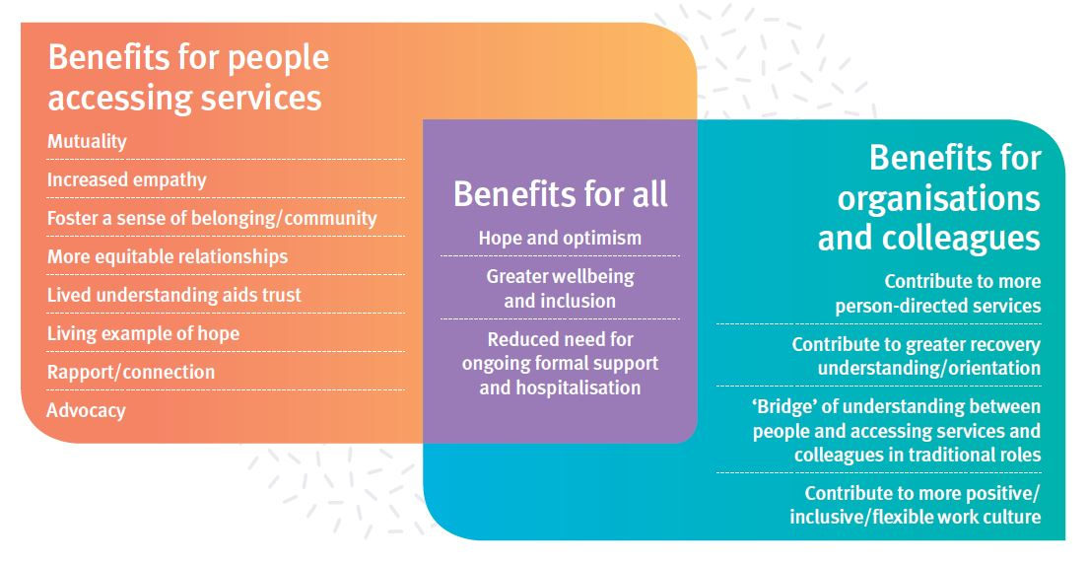
Factors that drive the need for the Framework

Slide 11
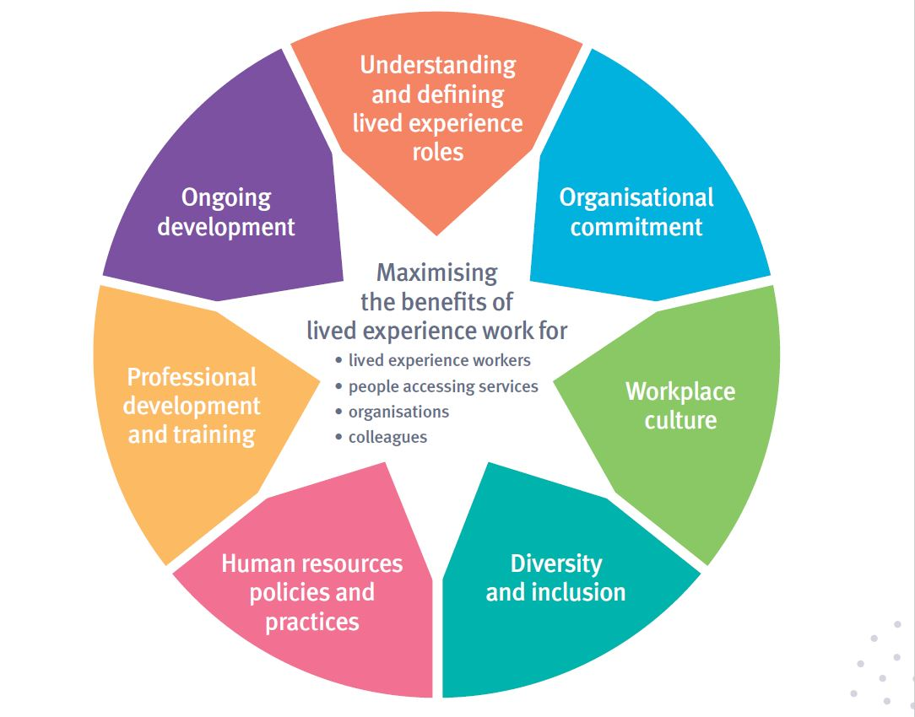

Slide 12
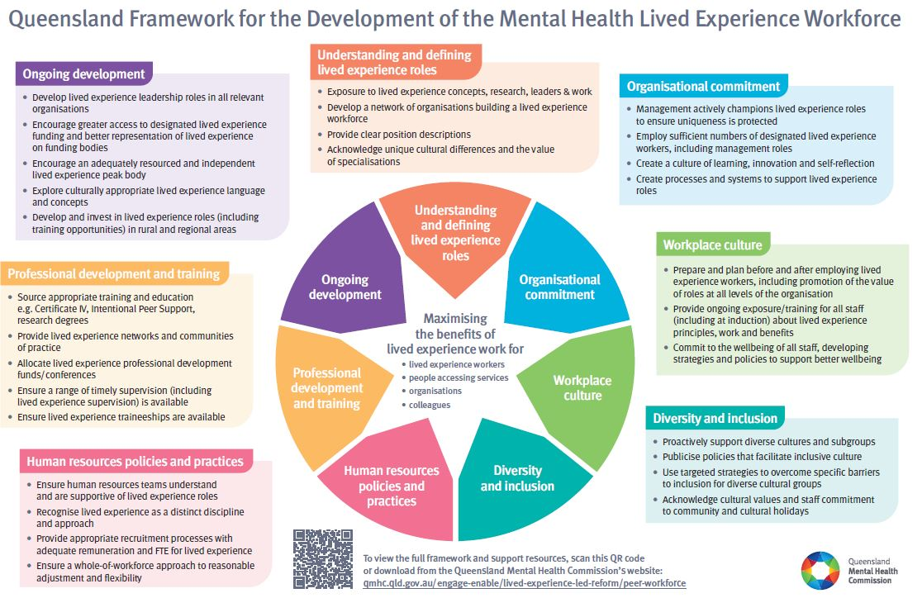

Slide 15
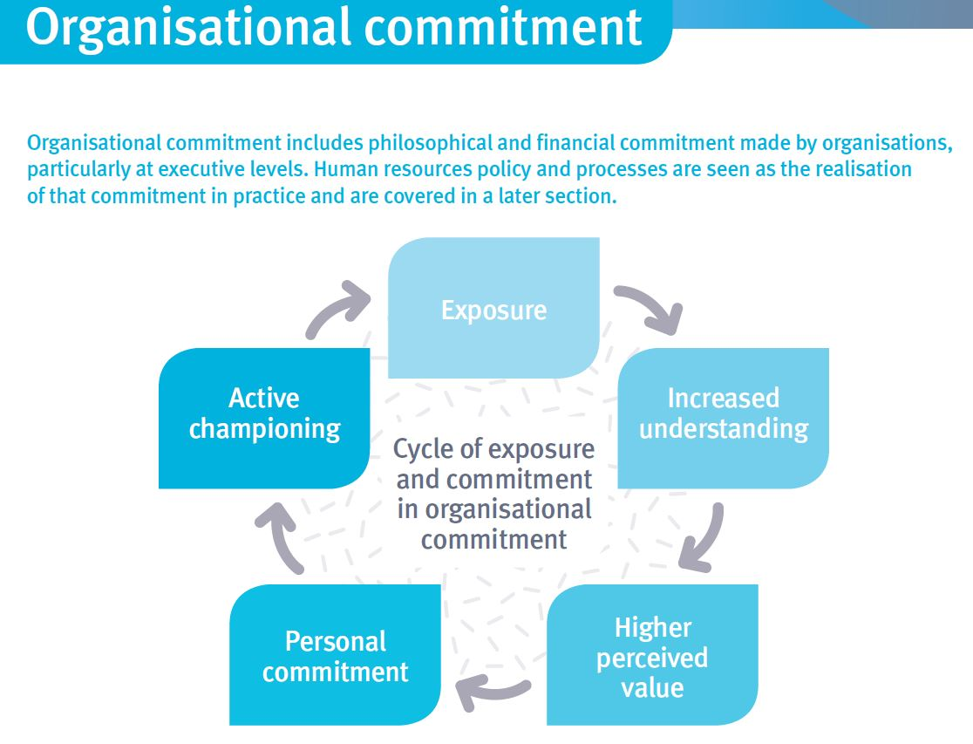

Slide 21
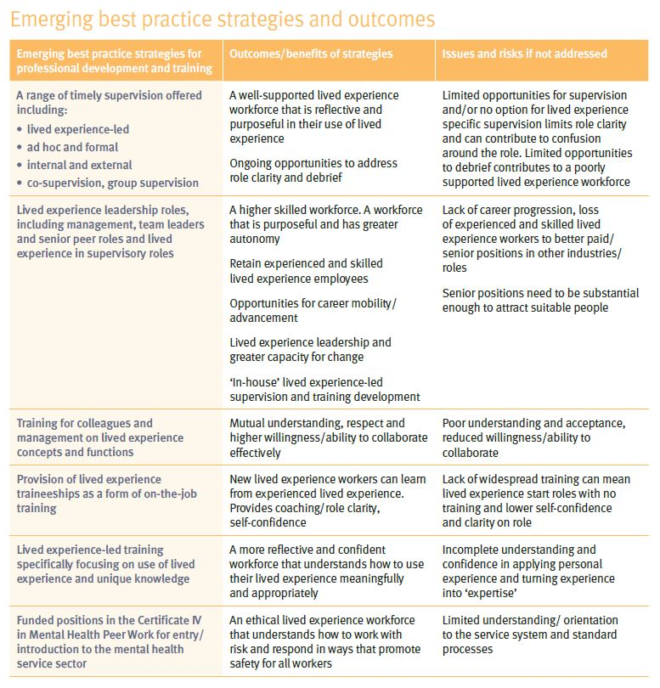

Slide 24
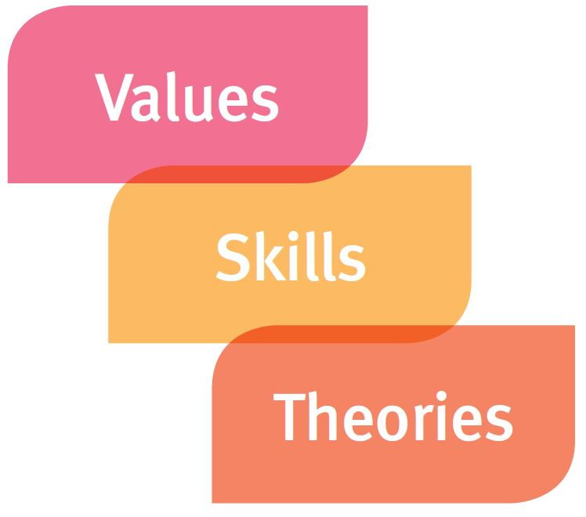

Slide 26
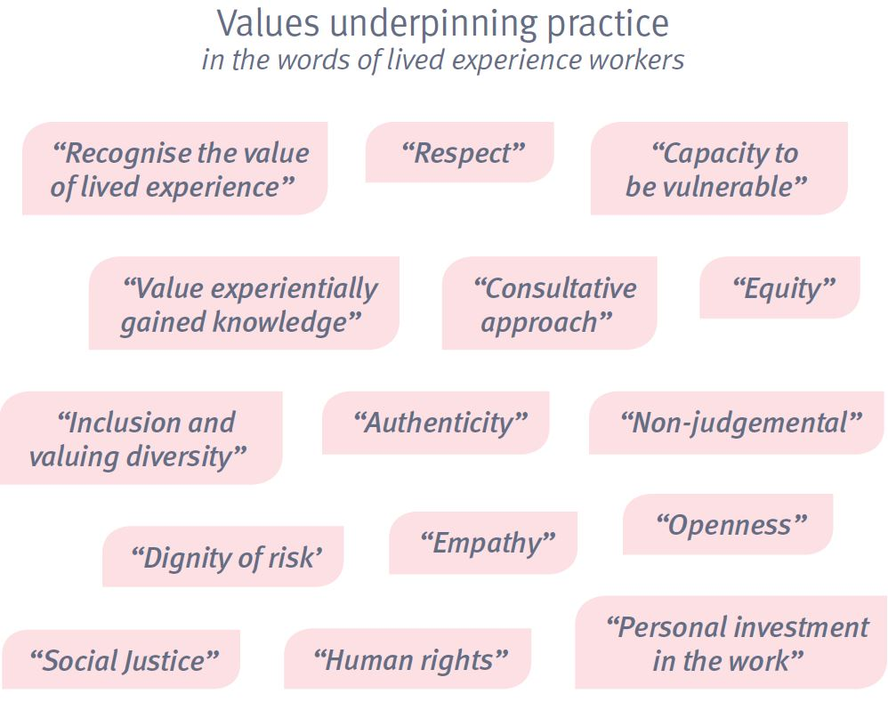

Slide 30
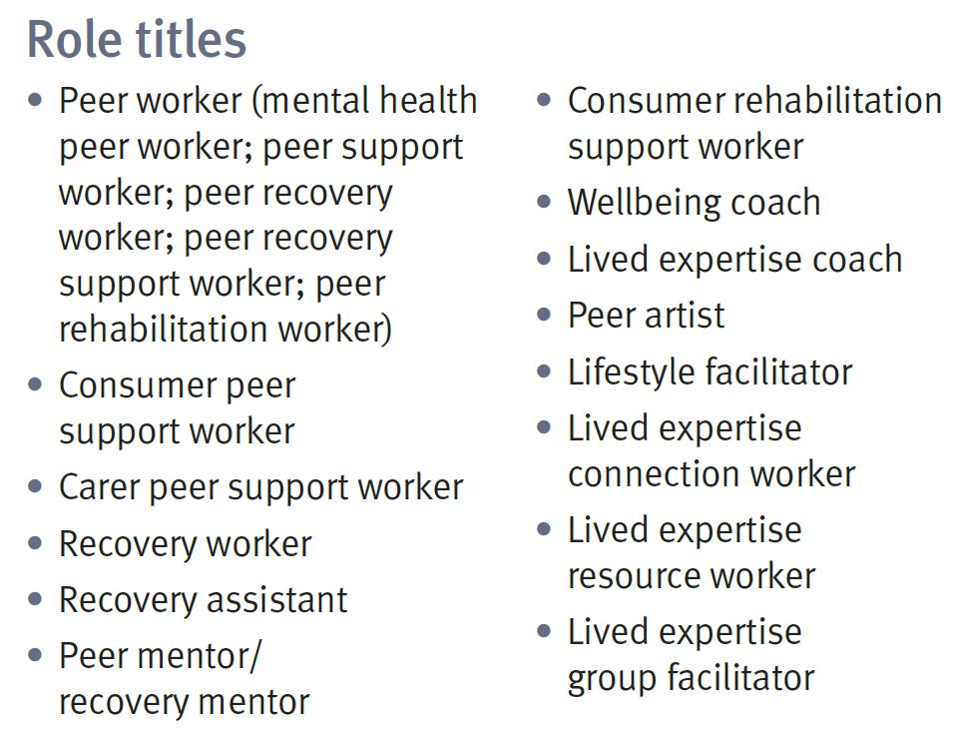

Slide 32
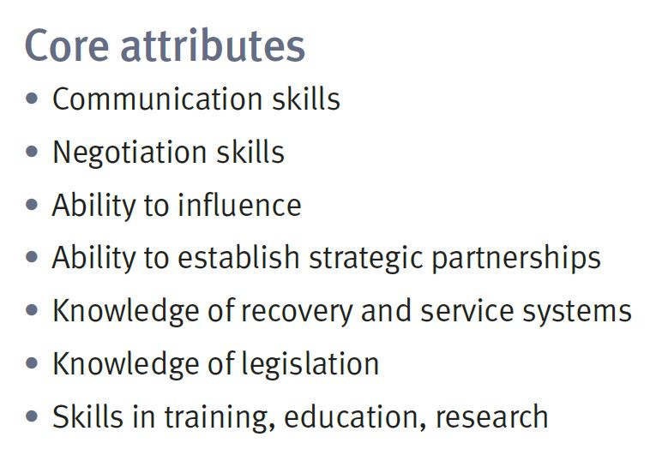
Indirect Roles

Slide 33
What’s next….

Slide 34
What do we need to know more about?
Cultural considerations including language to foster greater cultural diversity in peer positions
Strategies to foster diversity in peer work more broadly including identifications and life experiences (e.g.: people with disability, LGBTQIA+ communities)

Slide 35
What do we need to know more about?
Unique or additional considerations for peer workers working in compulsory treatment and inpatient settings. Particularly in relation to coercive or restrictive practice
Unique or additional considerations for peer workers and organisations in rural and remote locations?
Specific high-level recommendations that governments/organisations could implement including recommendations for funding

Slide 36
What do we need to know more about?
Resources or tools currently available that support organisations to effectively employ and support the peer workforce and can be endorsed by the Guidelines
Resources or tools people would like to see developed to assist the meaningful use of the Guidelines and further embed peer work

Slide 37
For more from me…
@DrLouiseByrne
Researchgate.net/profile/Louise_Byrne2
‘Mental health but not as you know it’ https://youtu.be/01rwdqqaE4g
Notes:
Send: https://www.qmhc.qld.gov.au/engage-enable/lived-experience-led-reform/peer-workforce

