Slide 1
Supporting Peer Professionals
Through Trauma Informed Weekly Supervision and Group Support

Slide 2
Introductions
About Us
Who’s in the Room?

Slide 3
Objectives
Understand the complexities of using lived experience in a peer role
2. Deepen awareness of supervision challenges and needs
3. Introduce Trauma Focused Supervisory and Group Format
4. Develop own supervision plans to take back to your organization

Slide 4
Acknowledging the Weight of the Position
How We Got Here………
Parent, family, peer, youth advocate role requires some form of lived experience that touched some form of system of care.

Slide 5
Acknowledging the Weight of the Position
As a partner our folks are choosing to
Communicate the parent/youth perspective while on treatment teams
Interrupt bias & prejudice against parent/youth as it occurs
Convince others to see parent/youth in a positive light
Identify & communicate family needs
Demonstrate techniques for assisting others in recognizing family needs
Demonstrate the ability to avoid blame in telling stories & relating facts
Analyze details of & communicate personal stories in a way in which others find helpful

Slide 6
Acknowledging the Weight of the Position
Sharing our Story……
The Goldilocks Principle
Too much detail
Failed engagement
Too little detail
Failed engagement
Just the right amount of detail & personal sharing
The heart of the narrative

Slide 7
Activity
In groups share:
What has been your experience with sharing your story (or with those you supervise)?
What are your reflections on how often staff are sharing their lived experience and the vicarious trauma impact it may have on them?
Are there parts of your/their story that ever feels like it may be too personal to share?
Report Out to Larger Group

Slide 8
Acknowledging the Weight of the Position
Being a Peer Advocate Can Be ________.

Slide 9
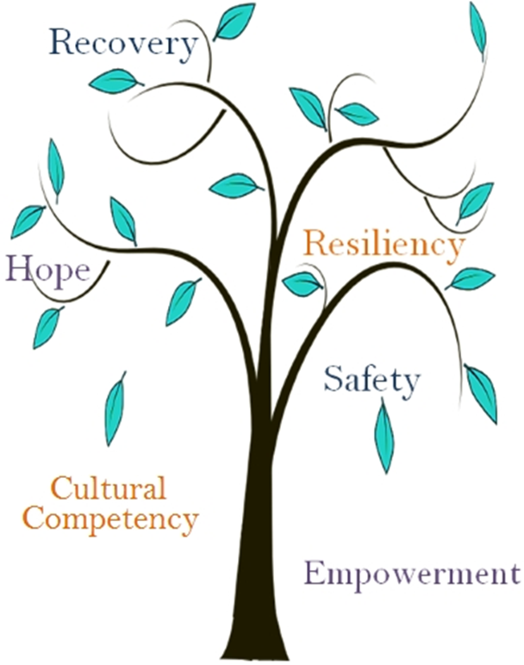
Supervising Through a Trauma Informed Lens

Slide 10
Supervision and Group Support
Weekly:
1 time a week- staff receive an hour of consultation/supervision
Bimonthly:
Team Meetings
Every 3 weeks:
Vicarious Trauma Group
1 Month:
Cross Program Collaboration – Intervention Group

Slide 11
Group Support (Safety/Empowerment)
Cross Program Collaboration- Intervention Group
Group Make Up: Facilitator, employees doing intervention work, youth advocates, family/parent partners
Duration: 1 hour 1 time a month
Topic: Behavioral change work, challenges, & self care

Slide 12
Cross Program Collaboration Meeting Outline
45 mins: Case Consults –Open it up to process challenging cases
What is the Targeted Behavior?
What Interventions have you used?
10 mins: Self-Care Check in
What have you done to take care of yourself?
What will you do for yourself this week?
5 mins- Who is facilitating next CPC Group?

Slide 13
Cross Program Collaboration
The goal of the group is to provide a space for collaboration, community, inspire hope, discuss safety concerns, and intervention work/activities.

Slide 14
Group Support (Resiliency/Recovery)
Vicarious Trauma Group
Group Make Up: All Peer Advocates
Duration: 1.5 hour every 3 weeks
Topic: Vicarious Trauma in the work we do

Slide 15
Vicarious Trauma Group Format/Topics
Format
Attendance is mandatory
Facilitator
Open discussion
In closing grounding activity or self care planning
Topics
Self-Awareness
Closing work rituals
Barriers
Self-Care Accountability

Slide 16
Vicarious Trauma Group
The goal of the group is to encourage resiliency as it helps to combat burn out and compassion fatigue.

Slide 17
Team Meeting (Hope/Cultural Competency)
Team Meetings
Group Make Up: All Peer Advocates
Duration: 2 hour every 2 weeks
Topic: Educational, Supportive, Fun, & informative

Slide 18
Team Meeting Structure
Facilitated by leadership
Utilize an agenda
Create an open culture – connect in a fun way before content
Recognize and celebrate
Train or refresh on topics
Encourage opportunities for team member growth
Make it fun

Slide 19
Individual Supervision (Safety/Empowerment)
Consultation/Supervision
Group Make Up: Supervisor and peer advocate
Duration: 1 hour a week

Slide 20
Consultation/Supervision
The goal of consultation/supervision is to focus on the individual being supervised and the work they are doing. This weekly hour long sessions allow for follow up on cases, vicarious trauma coping skills, cultural competency check ins, and professional growth.

Slide 21
The Mindful Supervisor
Bias
Countertransference/Transference
Self-Care
"Surrender to what is. Let go of what was. Have faith in what will be.“ –Sonia Ricotti

Slide 22
Activity
Develop Supervision/Group Plans

Slide 23
Questions, thoughts, & insights

