Slide 1
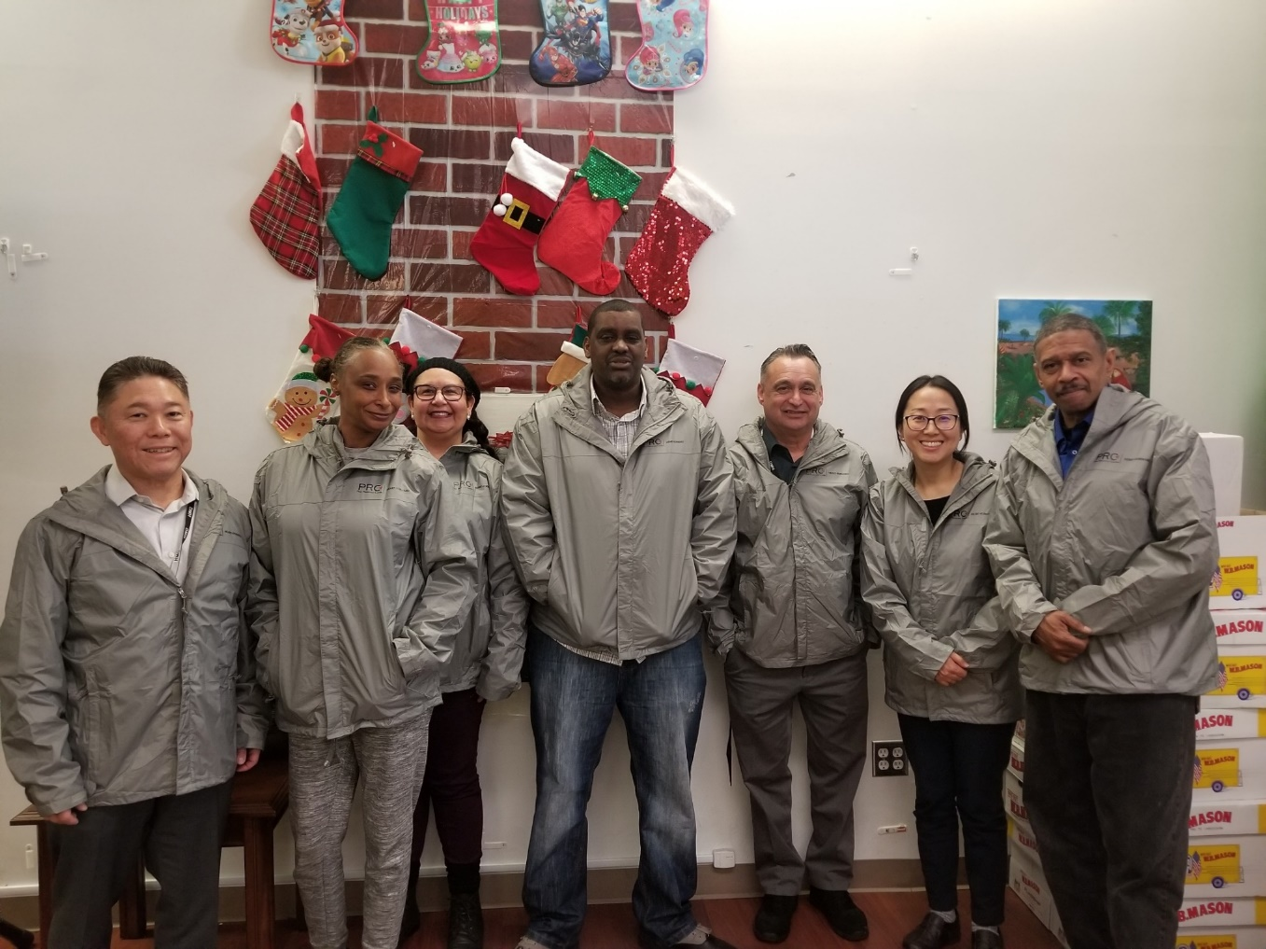
Peer Resource Center
Mission:
“Everybody leaves with something”

Slide 2
PRC Team
Keris Jän Myrick, M.B.A., M.S. - Discipline Chiefs Peer Services
SCOTT HANADA, LCSW, MH Clinical Program Manager III
Joo (Eric) Lee, LMFT, MHSC II – Team Leader
Catherine Clay – Housing & Health Navigator
Eulos Charles Miller – Housing & Health Navigator
Laura Kerr – Employment Specialist
Joseph Cuevas – Art & Recreation Specialist
David Snell – Computer Specialist
PRC staff have lived-experience and knowledge in various resources
WOW Volunteers with lived-experience

Slide 3
Opening Day
May 1, 2017

Slide 4
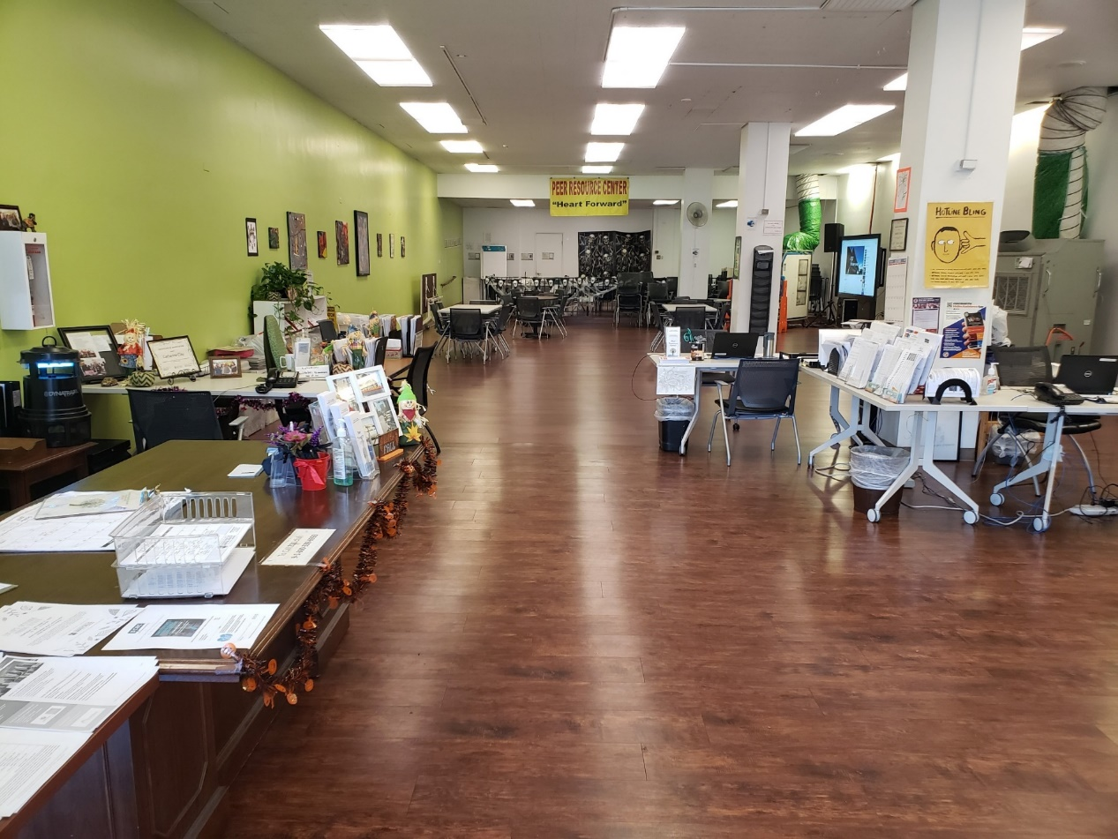
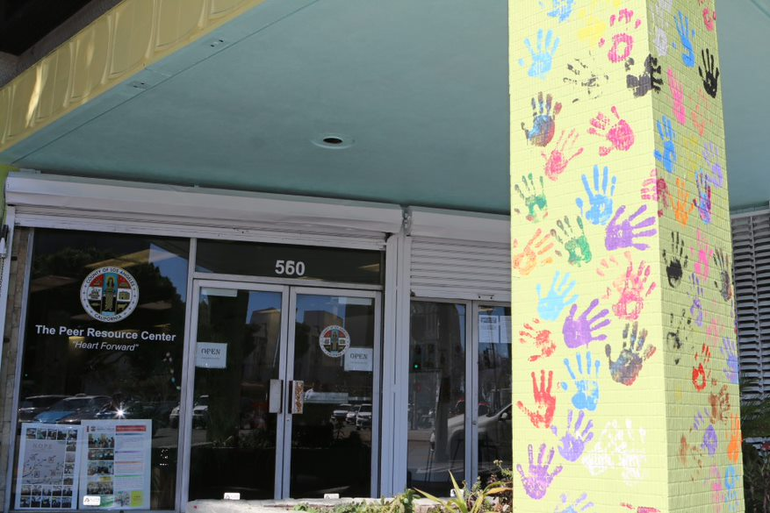
Peer Resource Center

Slide 5
Peer Resource Center
Form heart-forward connection with every visitors.
A comfortable, safe, and non-judgmental environment to all.
Place of clear intention:
Develop a positive connection with all visitors through Peer Support
Provide linkage and referral to appropriate community resources
Make sure that everyone leaves with something

Slide 6
Linkage Services to Peers
PRC Staff and WOW Volunteers are available to offer linkage and warm handoffs to community organizations.
Visitors can be linked to below services
Mental Health Services
Physical Health Services
Food
Clothing
Hygiene Facilities
Housing Services
PATH
Homeless Healthcare
Temporary Shelter
Benefit Establishment
Legal Services
Education and Job Training
Volunteer & Employment Opportunities
LAHSA WINTER SHELTER PICK UP

Slide 7
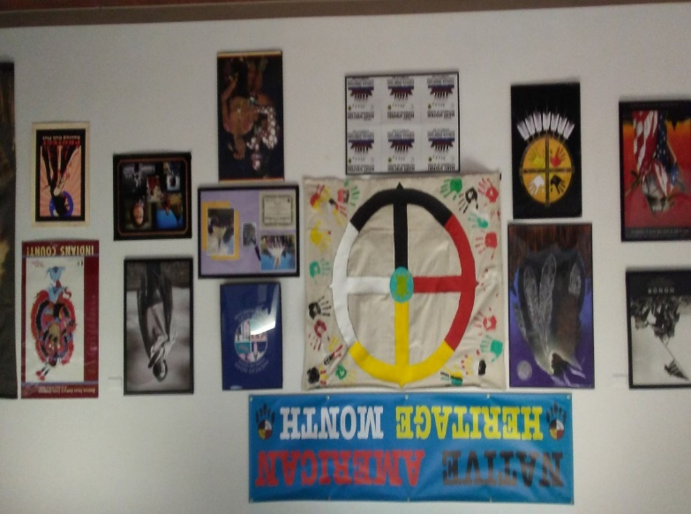
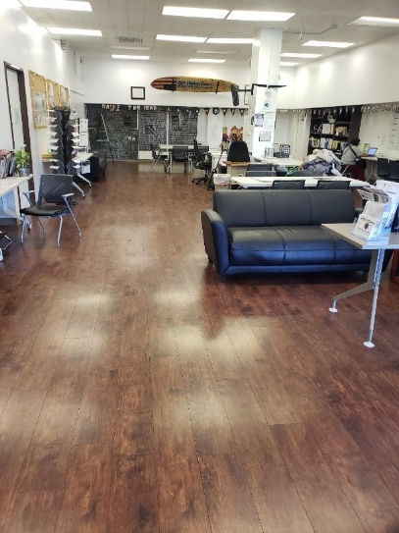
Activities at the PRC
Chess Group
Jewelry Group
Job Club
Barbershop
Art Group
Guitar Lesson
Singing & Healing
NAMI
Poetry, Creative Writing
Social Events
Cultural Events

Slide 8
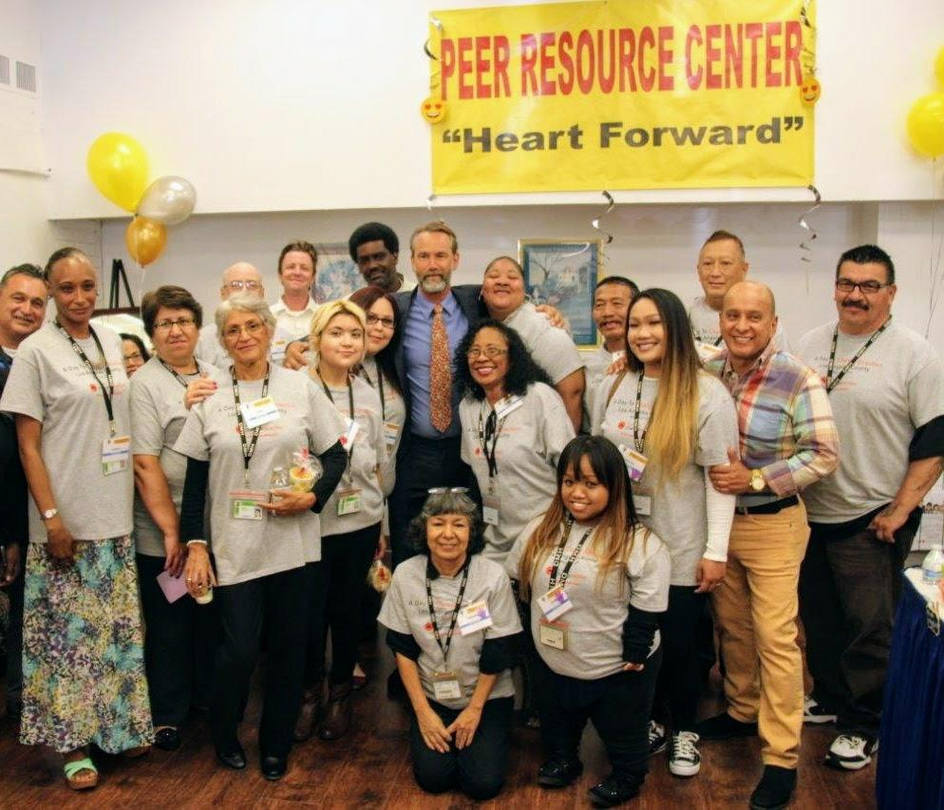
Hosting Community Events
End of Year Celebration with Community
New Year Kick-off / Super Bowl
Homeless Connect & Reconnect Day
May Mental Health
Halloween
Mental Health Awareness
Peer Resource Center Anniversary
Diverse Cultural Events
Native American Mental Health Promotion
Opens every 4th Saturday (8am – 4pm)

Slide 9
Participate in Community Events and Fairs
Resource Tables at Community Fairs and Events
BOS Empowerment Congress
Visiting the IMD Hospitals (Institution for Mental Disease)

Slide 10
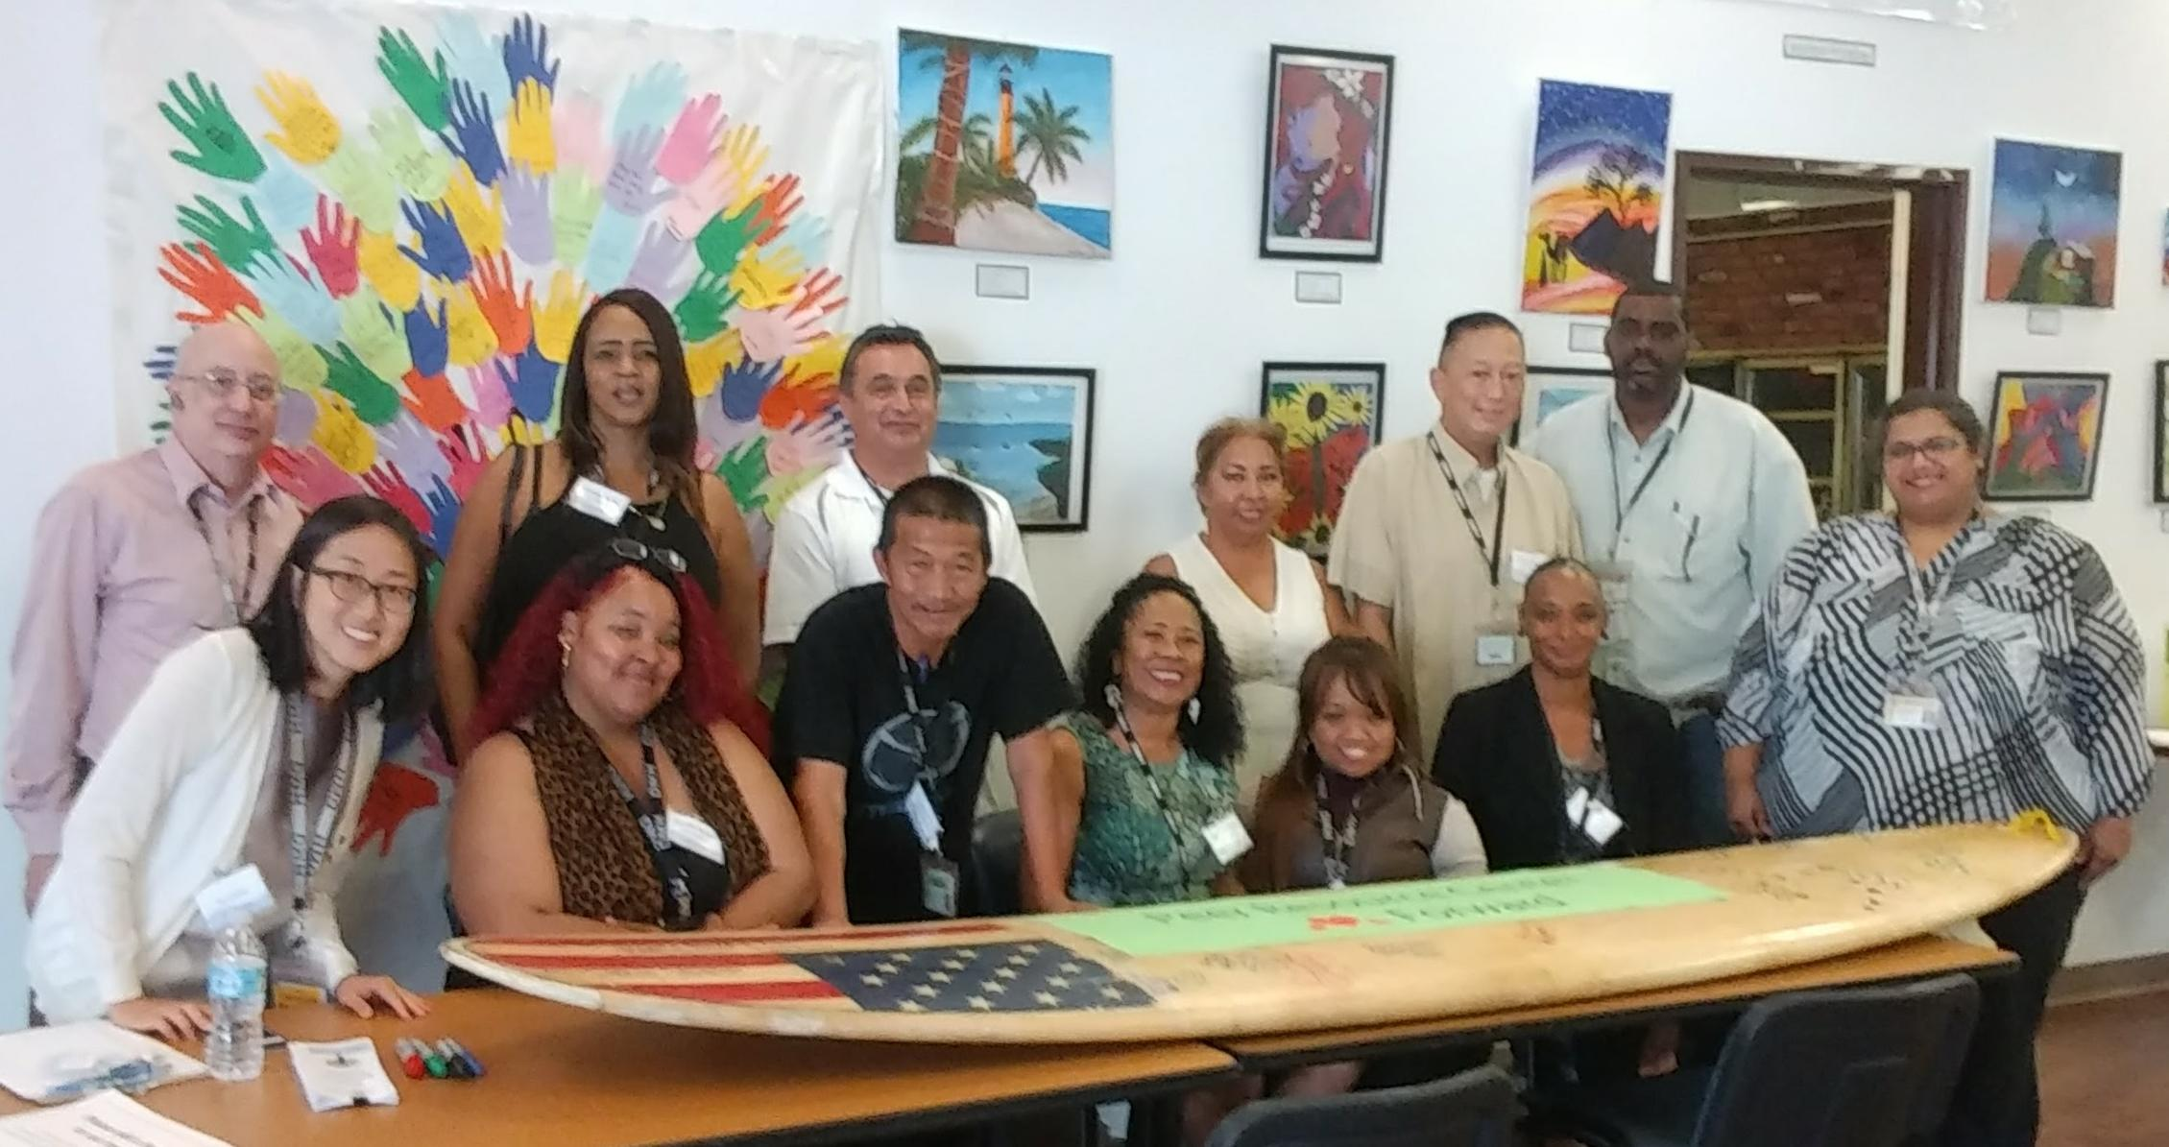
Volunteers & Staff
PRC started with
WOW Volunteers & Team

Slide 11
W.O.W -
Wellness Outreach Worker

Slide 12
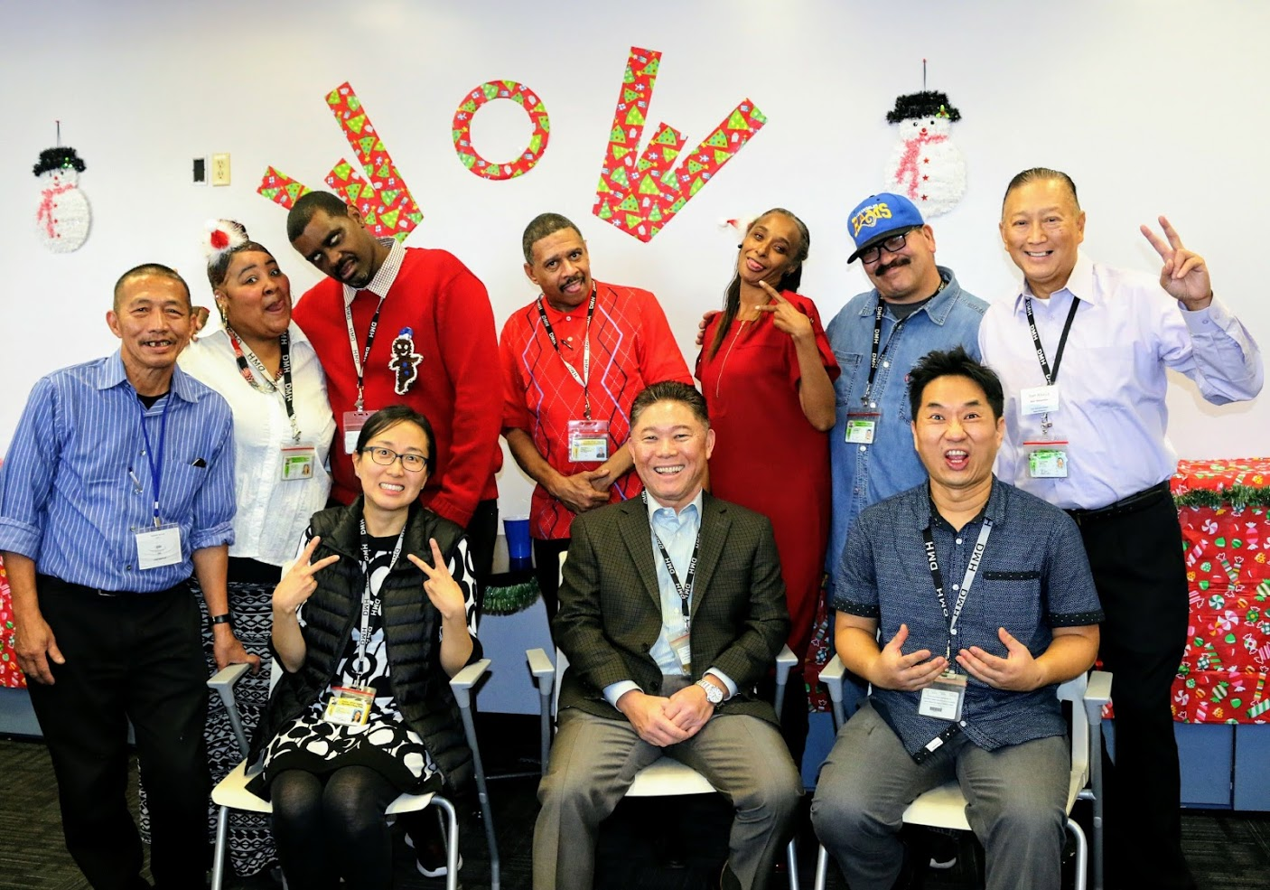

Slide 13
Stats and Averages.
3 year comparison:
2017
2018
More then 1000 people came through our doors in 2018 alone.
2019
Average of 47 visitors a day, Over 1000 visitors a month
46% identified to be homeless
We are aware that there are definitely more than that but they sometimes do not want to inform that they are homeless.
September 75 | October 133 | November 103 | December 209 | Average 130
September 70 | October 175 | November 241 | December 238 | Average 181

