Slide 1
tailoring the client-focused considering work model to an hiv peer program
Alliance for Positive Change
March 25, 2020
Erin McKinney-Prupis, Assistant Director, DrPH (abd)

Slide 2
Learning Objectives
At the conclusion of this webinar, participants will be able to understand how to:
Describe the Client-Focused Considering Work Model for Episodic and Emerging Disabilities
Design a peer program based on the Client-Focused Considering Work Model for Episodic and Emerging Disabilities
Identify program tools and assessments to evaluate peer programs
www.alliance.nyc

Slide 3
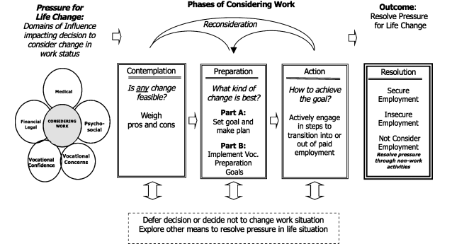
Client-focused considering work model for episodic and emerging disabilities (cfcwmee)
Conyers L. A client-focused considering work model for people with emerging or episodic illnesses. Journal Of Vocational Rehabilitation. 2018; 48:331-43.

Slide 4
Cfcwmee: Client focused
Self-Efficacy
Consumer Directed Theory of Empowerment
Self-Determination
Notes:
The model supports PLWH having the power to determine their future vocational directions; it does not assume work is the best decision for all PLWH.
A person’s self-efficacy empowers them to define and achieve their vocational goals through choosing the types of services they need.

Slide 5
Cfcwmee: domains of influence
Medical
Vocational Concerns
Vocational Confidence
Financial Legal
Psycho-social
Considering Work
Notes:
Psycho-social: Psychological and Social impacts of work
Financial and Legal impacts

Slide 6
Cfcwmee: phases of work

Slide 7
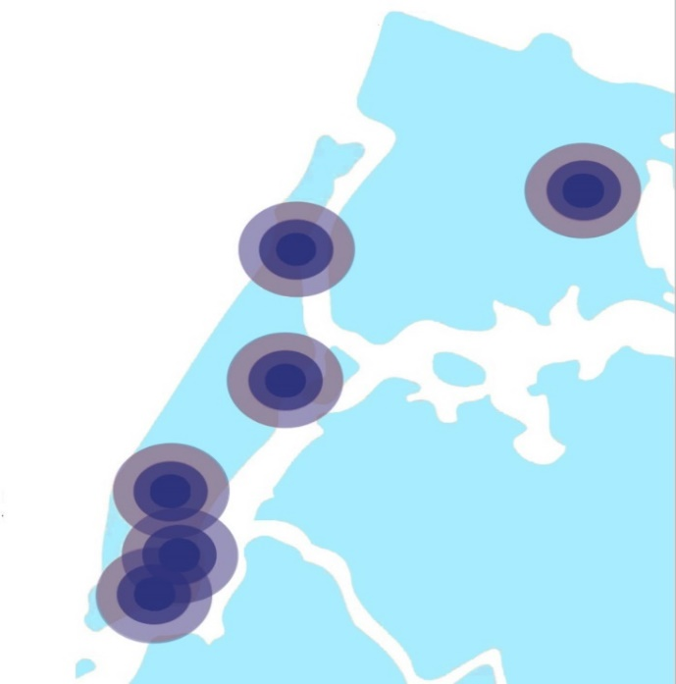
Positive Change in Action
Alliance for Positive Change helps New Yorkers affected by HIV and other chronic illnesses make lasting positive changes towards health, housing, recovery, and self-sufficiency.
Each year, we help New Yorkers:
Get tested for HIV
Overcome addiction
Access medical care
Escape homelessness
Rejoin the world of work
Replace isolation with community
And lead healthier and more self-sufficient lives.
Alliance’s individualized, full-service approach gives each person the unique
mix of support he or she needs to
feel better, live better, and do better.
www.alliance.nyc

Slide 8
Alliance Service Populations at a Glance
Most clients have multiple chronic illnesses.
Assist in obtaining the needed care and support:
Housing: unsafe, unstable, threats of eviction, rent arrears, needed repairs
Mental Health Diagnosis: Depression, Anxiety Disorder, Bipolar Disorder
Food Insecurity
Entitlements: undocumented, Medicaid reactivation; spend-downs
Mental Health Conditions (62%)
HIV/AIDS (55%)
Diabetes
(20%)
Alliance Service Population
Chemical Dependency History
(52%)
Asthma
(23%)
Hepatitis
(26%)
Cardiovascular (38%)
www.alliance.nyc

Slide 9
Peer training @ alliance
Since 1992, Alliance has been designing and delivering innovative peer education and training programs that create the economic, social and health-related building blocks to empower Peer trainees to take control of their lives by improving their health, sustaining long-term recovery from substance abuse, and developing marketable skills.
Alliance’s Peer trainings and Peer-delivered services are conducted by multilingual staff and Peer Educators who reflect the target population in terms of cultural, social, and experiential backgrounds
Photo: David Nager/Alliance
www.alliance.nyc

Slide 10
Peer TRAINING, INC. (PTI)
In 2013, Alliance created Peer Training, Inc. (PTI) to provide Peer Certification Training and paid Peer Placements at medical and social service agencies.
Alliance / PTI is a
NYSDOH authorized training center for both Foundational and Peer Certification trainings.
OASAS authorized training center for Recovery Coach trainings
Photo: David Nager/Alliance
www.alliance.nyc

Slide 11
Peer POWER
Peer Power is a programming model that drives economic development and social impact through role modeling.
Peers empower individuals to become community leaders and they inspire others to make healthy choices.
Photo: David Nager/Alliance
www.alliance.nyc

Slide 12
Role of Peer Navigators
Shared Lived Experience:
Culturally
Linguistically
Socially
Reduce Barriers to Care
Economically
Foster Trust
Promote Long-term Engagement
Guide Patients Toward Health and Stability
Photo: David Nager/Alliance

Slide 13
Role of Peer Navigators
Peer Navigators are integral members of Alliance’s Care Management Program. Peers conduct:
Outreach for Patient Activation/Linkage to Care
Patient Navigation, Appointment Reminders, Accompaniment to Services
Coaching / Health Education
Motivational Interviewing & Goal Setting
Self-Management & Adherence Support
Case Conferencing/Communication with care team
Photo: David Nager/Alliance
www.alliance.nyc

Slide 14
Limitations of cfcwmee
It does not address the unique challenges of Peers.
The model offers an effective global perspective concerning the processes people living with HIV experience when considering work. The model does not define specific systems that programs can utilize to implement the model.

Slide 15
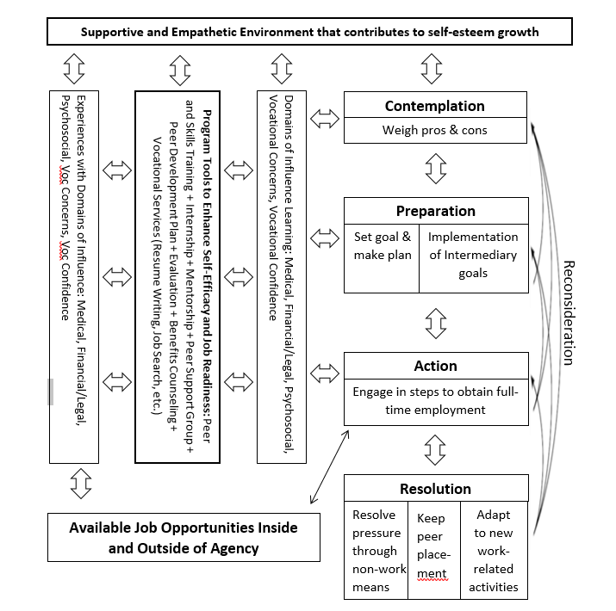
Tailoring the Client-focused considering work model for episodic and emerging disabilities for peer programs

Slide 16
Program tools aligned with CFCWMEE: MENTORSHIP & evaluation
Photo: David Nager/Alliance

Slide 17
Program tools aligned with CFCWMEE: GOAL SETTING
Photo: David Nager/Alliance

Slide 18
Program tools aligned with CFCWMEE: SUPPORT GROUP
Photo: David Nager/Alliance

Slide 19
Program tools aligned with CFCWMEE: VOCATIONAL SERVICES
Photo: David Nager/Alliance

Slide 20
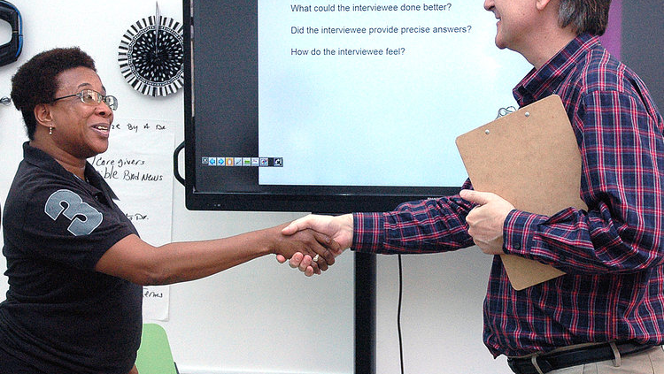
UTILIZING cfcwmee FOR PROGRAM EVALUATION
Photo: David Nager/Alliance

Slide 21
Thank you!
www.alliance.nyc
Erin@alliance.nyc
Waverly@alliance.nyc
www.alliance.nyc

