Slide 1
PEER VALUES
IN ACTION
RPLYT & the Centre © 2020

Slide 2
“Recovery is a personal journey of discovery. It involves making sense of, and finding meaning in what has happened; becoming an expert in your own self care; building a new sense of self and purpose in life; discovering your own resourcefulness and possibilities and using these, and the resources available to you, to pursue your aspirations and goals” [Perkins et al 2012]
RPLYT & the Centre © 2020

Slide 3
WHAT IS THIS “THING” WE CALL PEER SUPPORT
RPLYT & the Centre © 2020

Slide 4
“Peer support is not scripted. It does not follow steps. It is about relationship. It comes from the heart through insight and knowledge gained from experience.”
Source: Mental Health Commission of Canada, Guidelines for the Practice and Training of Peer Support.
RPLYT& the Centre © 2020

Slide 5
It’s Not About The Nail
RPLYT & the Centre © 2020

Slide 6
FRIENDSHIP
FIGURE 1-SPECTRUM OF TYPES OF PEER SUPPORT
Informal PEER SUPPORT Naturally occurring, voluntary, reciprocal relationship(s) with peers one-to-one or possibly in a community
Clubhouse/walk in centre Mainly psychosocial and social recreational focus with peer support naturally occurring among participants
Self-Help, Mutual PEER SUPPORT Consumer operated/run organizations/activities/programs, voluntary, naturally occurring, reciprocal relationships with peers in community settings e.g., housing, social/recreational, arts/culture, traditional/spiritual healing, recovery education/work, anti-discrimination education/work, human rights/disability rights education work
Formalized/Intentional PEER SUPPORT Consumer run peer support services within community settings (either group or one-to-one) focusing on issues such as education, employment, MH systems navigation, systemic/Individual advocacy, housing, food, security, internet, transportation, recovery education, anti-discrimination work, etc.
Workplace PEER SUPPORT Workplace-based programs where employees with lived experience are selected and prepare to provide peer support to other employees within their workplace
Community clinical setting PEER SUPPORT Peer support workers are selected to provide support to patients/clients that utilize clinical services e.g. Outpatient, A.C.T teams, Case Management, Counselling
Clinical/conventional MH system-based PEER SUPPORT Clinical setting, Inpatient/outpatient, institutional peer support, multidisciplinary groups, recovery centres, or Rehabilitation Centres Crisis response, Crisis Management, Emergency Rooms, Acute Wards
PEER SUPPORT
CLINICAL CARE
RPLYT & the Centre© 2020

Slide 7
“Formalized peer support begins when persons with lived experience, who have received specialized training, assume unique designated roles…to support an individual’s expressed wishes.”
Source: Addictions and Mental Health Ontario’s, Best Practices in Peer Support (from Ontario Peer Development Initiative)
RPLYT & the Centre © 2020

Slide 8
How do we get Consistency in the Discipline of Peer Support?
RPLYT & the Centre © 2020
Notes:
Selkirk Mental Health Centre (SMHC) – 25 years (1995 – present)
Service Purchase Agreement between MSS and SMHC for Peer Support Worker to provide the following 3 days per week:
One-on-one peer support on the ward
Support groups
Hearing Voices that are Distressing for new employee orientation and community workshops
Actively sits on the patient and family advisory committee

Slide 9
Mental Health Commission of Canada’s Core Values
Hope and Recovery
Empathetic and Equal relationships
Integrity, Authenticity and Trust
Self determination
Dignity, respect and social inclusion
Health and Wellness
Lifelong learning and personal growth
RPLYT & the Centre © 2020

Slide 10
BUT I HAVE QUESTIONS:
Confidentiality: Why don’t they tell us everything?
Why don’t they use “our” language?
Why don’t they just make people follow the “treatment” plan?
What if they get triggered/Self Care?
Boundaries/Dual relationships?
What about Documentation?
RPLYT & the Centre © 2020

Slide 11
Supervision
RPLYT & the Centre © 2020

Slide 12
So…how do we stay true to peer support values?
RPLYT & the Centre © 2020

Slide 13
Lisa McVey,
Admin Assistant
lmcvey@shhalton.org
Robyn Priest,
International Advisor & Trainer
(Part Time)
robyn@robynpriest.com
Betty-Lou Kristy, Director
bkristy@shhalton.org
Alyssa Gremmen
Peer Integration and
System Lead
agremmen@shhalton.org
Jody Orr,
Embedded Evaluator
(Part Time)

Slide 14
Services
Support 11 funded & accredited Health Service Providers (HSPs)
Over 40 peer support workers
24 peer supervisors across 25 different programs in community, residential & hospital settings
6 Priority Streams
Training
Implementation
Evaluation & Research
Capacity Building
Knowledge Brokerage
Quality Improvement
7 Areas of Reflective Practice
Person Directed Services
Developing a New Role in a System
Emergence
Governance
Service Integrity
Communities of Practice
“Marrying” all of those
RPLYT & the Centre © 2020

Slide 15
How did we set a priority? Peer worker survey completed over June & July 2016
What emerged from the peer support worker survey suggested great complexity in what peer support workers were doing and how they were doing it
Each service provider had unique expectations about roles and responsibilities for “their” peer support positions.
Role clarity and role definition were identified as top priority for the peer support workers, the peer support supervisors, and the agencies employing the peer workers.
RPLYT & the Centre © 2020

Slide 16
Definitions from the Centre
What is peer support?
“Peer support is intended to be rooted in hope through an empowering and empathetic relationship between people who have a similar life experience or circumstance in common” *
Who is a peer worker?
“Someone who has a similar life experience or circumstances to yours. They have engaged in special training and skill development to enhance their ability to support you in living the life you want.” *
*These definitions were created with the collaboration of the Peer Position Network (40+ peer staff from over 11 organizations) and Peer Positions Supervisor Networks (25+ Peer Supervisors from over 11 organizations)
RPLYT & the Centre © 2020

Slide 17
Was authentic peer work being offered?
What we could NOT find in the research…
What we needed to know….
RPLYT & the Centre © 2020
Notes:
Selkirk Mental Health Centre (SMHC) – 25 years (1995 – present)
Service Purchase Agreement between MSS and SMHC for Peer Support Worker to provide the following 3 days per week:
One-on-one peer support on the ward
Support groups
Hearing Voices that are Distressing for new employee orientation and community workshops
Actively sits on the patient and family advisory committee

Slide 18
What became clear….
We could not measure the outcomes of peer work in the region if we did not know if authentic peer work (based on the values) was being provided to people.
We needed to find a way to measure the perceived values based behaviours people receiving services were/or were not experiencing to create baseline data.
There was little research on directly what values based behaviours looked like. (Provincial Systems Support Program’s (PSSP) Evidence Exchange Network EENet) housed at Centre for Addiction & Mental Health (CAMH) completed a literature review for us to support this)
We needed to ensure a credible research methodology process/rigour, so our work could be seen as evidence in our region to continue moving peer work forward.
RPLYT © 2020

Slide 19
Service Integrity, Quality and Impact Survey
Perception of people receiving peer support about:
Values in action being experienced or not
Service quality
Service impact
IT IS ABOUT quality improvement
not performance management
RPLYT & the Centre © 2020

Slide 20
The Centre created a validated tool to measure…
1. Integrity- Is peer work actually taking place
Integrity
Is peer work actually taking place?
Quality
How are people feeling about services/peer services?
Impact
Do people feel peer work is impacting what the evidence has said it does?
RPLYT & the Centre © 2020
Notes:
Integrity – using the values in action to measure

Slide 21
Integrity Findings
Is values-based peer work occurring?
The mean (average) score for all items was very positive, people were experiencing the values in action!
RPLYT & the Centre © 2020

Slide 22
Integrity Results Mean Scores of Service Integrity Measures (Highest Possible Score is 5)
Statement Linked to Peer Support Values | Mean Score | Rating
The peer support worker tells me my feelings and opinions are worthwhile. | 4.50 | Very Positive
The peer support worker reminds me that I have the right to express my needs. | 4.48 | Very Positive
The peer support worker tells me about their experiences in a way that is meaningful to me. | 4.47 | Very Positive
The peer support worker does not express disapproval of me or the choices I make. | 4.46 | Very Positive
The peer support worker discusses confidentiality with me. | 4.46 | Very Positive
The peer support worker reminds me that my health and wellness is unique to me. | 4.46 | Very Positive
RPLYT& the Centre © 2020

Slide 23
Integrity Results Mean Scores of Service Integrity Measures (Highest Possible Score is 5)
Statement Linked to Peer Support Values | Mean Score | Rating
The peer support worker demonstrates ways they take care of themselves. | 4.46 | Very Positive
The peer support worker follows through on commitments they make. | 4.44 | Very Positive
The peer support worker encourages me to do things for myself instead of doing things for me. | 4.42 | Very Positive
The peer support worker tells me they believe in me. | 4.41 | Very Positive
The peer support worker learns from me and I learn from them. | 4.38 | Very Positive
The peer support worker helps me explore options open to me when I have a decision to make. | 4.35 | Very Positive
RPLYT & the Centre © 2020

Slide 24
Integrity Results Mean Scores of Service Integrity Measures (Highest Possible Score is 5)
Statement Linked to Peer Support Values | Mean Score | Rating
The peer support worker genuinely listens to me. | 4.64 | Very Positive
The peer support worker gives me encouragement. | 4.62 | Very Positive
The peer support worker tells me that I am not alone in my experiences and struggles. | 4.59 | Very Positive
The peer support worker shares information with me, e.g., community resources that are available, different learning opportunities. | 4.56 | Very Positive
When I meet with others in a group, the peer support worker tells me that I can participate in a way that is comfortable for me and the group. | 4.55 | Very Positive
RPLYT & the Centre © 2020

Slide 25
Quality Findings
How does receiving peer support affect people’s feelings about services they are receiving?
70% experienced negative emotions before peer support, 80% positive emotions with peer support
RPLYT & the Centre © 2020

Slide 26
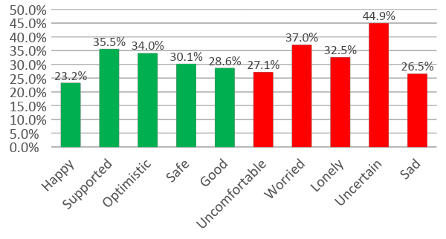
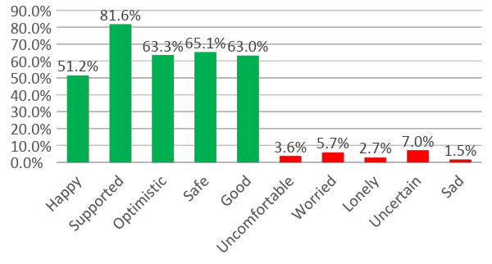
Quality Results
Words People Used to Describe Their Feelings about Services Prior to Receiving Peer Support
%
Words People Used to Describe Their Feelings about Their Meetings With Peer Support Staff
%
RPLYT & the Centre © 2020

Slide 27
Impact Findings
Do people believe peer support is having an impact on their day to day life?
More than 75-80% agreed or strongly agreed that having peer support:
Helped them be more hopeful about their life
Gave them more confidence to tell health providers what they need
Helped them deal more effectively with crises in their life
Helped them get connected to appropriate supports and services
Improved their ability for self-care
Decreased their need for emergency and crisis services
Improved their experience with mental health and addiction services!

Slide 28
Impact Results Perceived Impact of Peer Support Mean Scores (Highest Possible Score is 5)
Meeting with a peer support worker has …* | Mean Score | Rating
…helped me be more hopeful about my life. | 4.34 | Very Strong
…made my experience with mental health and addictions services better. | 4.34 | Very Strong
…helped me get connected to appropriate supports and services. | 4.27 | Very Strong
…given me more confidence to tell health providers what I need. | 4.23 | Very Strong
…improved my ability for self-care (i.e. activities and practices that are engaged in on a regular basis to maintain and enhance a person’s short- and longer-term health and well-being.). | 4.21 | Very Strong
…helped me deal more effectively with crises in my life. | 4.19 | Very Strong
RPLYT & the Centre © 2020
*Table adapted for slide. In the tool, each statement begins with: “Meeting with a peer support worker has…”

Slide 29
Survey & the “How To Manual”
We love to share!
www.centreforinnovationinpeersupport.com
info@centreforinovationinpeersupport.com

Slide 30
Thank You
QUESTIONS?
robyn@robynpriest.com www.robynpriest.com

