Slide 1
Supervision of Peer Workforce Project
Emotional Health Association & LAC Department of Mental Health
Funded by the Office of Statewide Health Planning and Development (OSHPD)

Slide 2
Cultural Competence: Becoming an Ally

Slide 3
Becoming an ally
PRESENTERS
Jason Robison, Program Director, SHARE!
Camille Dennis, Program Coordinator, SHARE!

Slide 4
Today’s Schedule
9:30 Start
11 am Break
12:30 Lunch
3 pm Break
4:25 Evaluations

Slide 5
In the end, we will remember not the words of our enemies, but the silence of our friends.
--Martin Luther King, Jr.

Slide 6
How do we define success for an ally?
Success needs to be realistic. Expecting someone to abandon their biased words and actions based on a few conversations is not realistic.
Success slowly builds tolerance for differences.
Success reduces the contagion of bigotry or prejudice.
Success gets people to think about what they are saying and doing.
Success gives voiceless people a voice.

Slide 7
Learning objectives
Relate current thinking in discrimination and cultural competency studies related to isolation and alienation.
Know at least five differences between dialogue and debate.
List at least three behaviors that support dialogue.
Demonstrate knowledge of “othering” and the impact it has on those experiencing it.
List six tools allies use to change behaviors in people whose behavior may exclude, stigmatize, and/or discriminate against people.
Develop a plan to apply knowledge and skills for being an ally to people who experience and feel discriminated against.

Slide 8
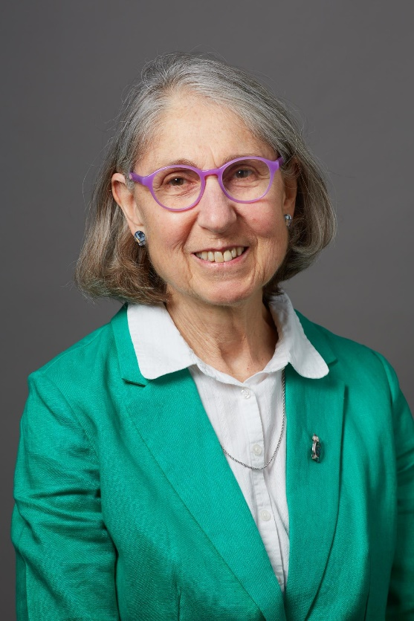
Research on Allies
Dr. Jessica Wolf, Assistant Clinical Professor
Yale University Department of Psychiatry

Slide 9
Becoming an Ally
Ally: A person or group that gives help to another person or group
(Merriam-Webster Dictionary)

Slide 10
The term ally
Comes from research on LGBTQIA (Lesbian, Gay, Bisexual, Transsexual, “Queer,” Intersex, Asexual) issues, referring to people who themselves are not LGBTQIA and who aim to end oppression of LGBTQIA people by
Supporting and advocating on behalf of LGBTQIA individuals and groups

Slide 11
The term ally may be used
In relation to any person or group, when someone who is not a member of a group being discriminated against supports and advocates on behalf of members of a group being stereotyped, put down or “othered.”
“Othering” means to view or treat a person or group of people as intrinsically different from and alien to oneself.
What are some examples of groups towards which biased, discriminatory or “othering” comments may be made?

Slide 12
Allies in the workplace are important because
They can have an impact in affecting attitudes and behaviors towards individuals and groups that are put down, discriminated against and “othered;”
Often possible allies outnumber those being discriminated against;
Involving allies can provide many workplace advocates who haven’t previously been engaged;

Slide 13
Allies are important because, continued
Involving employees in helping address diversity can take pressure off leaders as well as individuals who are targets of discrimination.
Taking pressure off leaders may have both positive and negative consequences. What might these be?
People who aren’t targets of discrimination are more likely to see prejudiced or discriminatory behaviors; usually have more power within organizations, and tend not to be targets of backlash when they confront prejudice, unlike those who are targets of prejudice.

Slide 14
How do people become allies?
People begin to realize they are different from others who are discriminated against and that those who are targets of discrimination have unique struggles;
Then they realize they could be doing more to help others who are discriminated against or “othered.”
Possible allies begin to learn more about those they seek to help and learn about “privilege,” referring to advantages of those belonging to so-called dominant groups in contrast to those who do not;
Possible allies identify ways they might help and begin practicing these;
They learn how to communicate new viewpoints to others, begin to feel comfortable calling themselves allies, and practice advocacy and support in safe environments.

Slide 15
What are some barriers that may hinder allies?
Anticipated negative reactions from others, either those who are or are not targets of discrimination or othering;
Sometimes people avoid conflict with others;
Allies may be afraid of being labeled as trouble-makers;
They may be afraid of being associated with those who are targets of discrimination;
Allies may fear not knowing enough about issues confronted by those who are othered and how to be most helpful;
Allies fear they may be seen as prejudiced.

Slide 16
Questions to consider
What motivates people to become active allies?
What individual and environmental factors prevent supportive co-workers from becoming effective allies?
What types of workplaces are most supportive of and encouraging towards being active allies?
What supportive behaviors are most effective?
What advocacy behaviors are most effective?
How can allies make sure they help others voice their concerns rather than becoming the voice of others?

Slide 17
“No civil rights movement can be successful without the active engagement of supportive … allies.” (Sabat, Martinez, & Wessel, 2013)
Today, in a safe, respectful space, we are exploring experiences of being othered, becoming allies and using skills and tools to reduce othering and increase belonging.
Today’s training is an effort to
learn how it feels to be othered or discriminated against;
feel empathy for those being othered;
understand how dialogue can help in being an ally;
learn specific tools to use as an ally;
increase feelings of belonging rather than feeling and being isolated.

Slide 18
Our vision is a world in which difference is celebrated and all people are valued. (See john a. powell and Stephen Menedian, http://www.otheringandbelonging.org/the-problem-of-othering/)

Slide 19
Othering
To other: view or treat (a person or group of people) as intrinsically different from and alien to oneself.
“Othering” is a set of dynamics, processes, and structures that result in marginality and persistent inequality across the full range of human differences based on group identities. “The opposite of Othering is not ‘saming,’ it is belonging. And belonging does not insist that we are all the same. It means we recognize and celebrate our differences in a society where ‘we the people’ includes all the people.” (paraphrase of john a. powell and Stephen Menedian, http://www.otheringandbelonging.org/the-problem-of-othering/ )

Slide 20
Othering Discussion
What is an early childhood experience of being othered or left out?

Slide 21
Othering Discussion
How do you feel hearing these stories?

Slide 22
The Magic of Dialogue
The difference between dialogue and debate
Why allies use dialogue
Daniel Yankelovich, The Magic of Dialogue: Transforming Conflict Into Cooperation, Touchstone, 1999

Slide 23
Dialogue in a nutshell
Listen to learn
Speak to share from your own experience
The goal is to learn as much as possible from others
Ask questions

Slide 24
Debate | Dialogue
Assumes there is a right answer, and I have it | Assumes that many people have pieces of the answer, and that together they can craft a solution

Slide 25
Group exercise: The Circle
Native American teaching: “Place an irregular shaped object in the center of a circle of people. Each person will describe it differently. Everyone in the circle will be right. Only by honoring and respecting everyone's input, can the truth about the object be revealed. We need to learn to honor differences.”
This teaching is copyright of Coyhis Publishing and can also be found in the book, Meditations with Native American Elders: The Four Seasons, frequently used in Wellbriety Circles. www.coyhispublishing.com.

Slide 26
Debate | Dialogue
Is combative—participants attempt to prove the other side is wrong | Is collaborative – participants work together toward common understanding.
It’s about winning | It’s about exploring common good
Entails listening to find flaws and make counter-arguments | Entails listening to understand, and find meaning and agreement
I defend my assumptions as truth | I reveal my assumptions for re-evaluation

Slide 27
Debate | Dialogue
I critique the other side’s position | I re-examine all positions
I defend my own views against those of others | I admit others’ thinking can improve my own
I search for weakness in other’s positions | I search for strength and value in others’ positions
I seek a conclusion or vote that ratifies my position | I discover new options

Slide 28
Behaviors that support dialogue
Suspension of judgement while listening and speaking.
Respect for differences
Role and status suspension
Balancing inquiry and advocacy
Focus on learning

Slide 29
Discussion
What stood out to you about the difference between dialogue and debate?
Why do allies need to dialogue, rather than debate?

Slide 30
Tools to be an ally
Get Ready
Identify the Behavior
Appeal to Principles
Set Limits
Find an Ally/ Be an Ally
Be Vigilant

Slide 31
Never doubt that a small group of thoughtful, committed citizens can change the world. Indeed, it’s the only thing that ever has.
--Margaret Mead

Slide 32
1. Get ready
Prepare yourself to speak up.
Open-ended questions: "Why do you say that?" "How did you develop that belief?"

Slide 33
2. Identify the behavior
Describe the behavior; don't label the person.
If you simply call someone a racist, a wall goes up.

Slide 34
3. Appeal to principles
Call on their higher principles.

Slide 35
Appeal to principles
Fair-minded Caring
Considerate Just
Tolerant Accepting
Broadminded Unbiased
Unprejudiced Moral
Ethical

Slide 36
4. Set limits
You cannot control another person, but you can ask them not to make comments, or leave their presence.
Follow through on your limits.

Slide 37
5. Find an Ally/Be an Ally
Seek out like-minded people and ask for support.
After you speak up, call your ally and discuss what happened.
If you aren't the first voice to speak up against everyday prejudice, be the next voice.

Slide 38
6. Be vigilant
Remember: Change happens slowly.
Make a commitment to keep speaking up.

Slide 39
Make a commitment
My allies are…
I commit to…

Slide 40
Nationally-informed Trainings
Strategies for an Effective Peer Workforce--Dec. & Jan. 2019
Cultural Competency: Becoming an Ally—February 2019
Trauma-informed Developmental Model of Supervision—March 26, 27, 28 2019
Stigma… in Our Work and in Our Lives—April 29, 20 and May 1& 2 2019
Participants are encouraged to attend all trainings in person. Online versions will be available for those who miss the training.

Slide 41
Opportunities
Form an Implementation Team on the peer workforce at your agency
Sign up for a mentor.
Questions? training@shareselfhelp.org

Slide 42
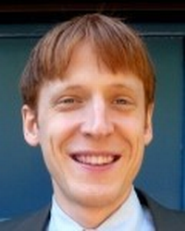
Evaluation
University of Texas professor Dr. Louis Brown will evaluate the effectiveness of the project in which 500 peers and supervisors from 89 sites are participating.
Louis.D.Brown@uth.tmc.edu

