Slide 1
Supervision of Peer Workforce Project
Emotional Health Association & LAC Department of Mental Health
Funded by the Office of Statewide Health Planning and Development (OSHPD)

Slide 2
Today’s Schedule
9:30 Start
11:15 Break
12:30 Lunch
3 pm Break
4:25 Evaluations

Slide 3
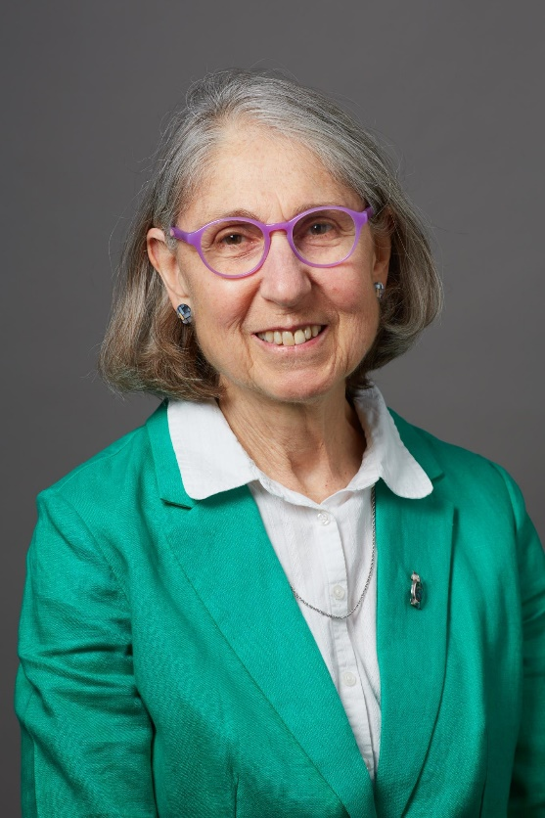
Supervision Foundation
Dr. Jessica Wolf, Assistant Clinical Professor
Yale University Department of Psychiatry

Slide 4
Trauma-Informed Developmental Model
PRESENTERS
Jason Robison, Program Director, SHARE!

Slide 5
We’re in this Together!
Are you ready for what comes next?
Providing supports and enhancing capacity of peer supporters and supervisors in the behavioral health workforce
Chyrell D. Bellamy, PhD, MSW, Assistant Professor & Director of Peer Support Services and Research
Yale University School of Medicine,
Department of Psychiatry
Program for Recovery and Community Health (PRCH)
[chyrell.bellamy@yale.edu]

Slide 6
So What are We Trying to Do?
Become more self aware (of assumptions, patterns, agendas etc.)
See beyond the surface
Build a connection that allows for co-learning (taking risks)
Use our story to inspire hope and invite other ways of seeing
Reflect - practice - action - reflect

Slide 7
Learning Objectives
Participants will:
Participants will be able to discuss practical tips for developing the capacity of peer supporters working in the behavioral and health workforce.
Participants will be able to understand and use practical tips for preparation as supervisors of peer supporters.

Slide 8
“Revolutions begin when people who are defined as problems achieve the power
to redefine the problem.”
John McKnight

Slide 9
Supervision experiences
What have your previous experiences of supervision been like?
What has been most helpful for you in supervision?
What did you find least helpful?

Slide 10
How Peer Supporters describe “GOOD” supervision?
Open to assist
Good Listener-what the peers have to say
Down to earth
Provides positive feed-back
Constructive
They are there-open door policy
Consistency
No favoritism
Honesty
Realistic expectations
Stay optimistic
Encourage staff to stretch the envelope
Empower to say no- related to taking on too much
Assignments outside of the job description
Moving towards-what are you going to do-what am I going to do
Don’t read between the lines
Realistic expectations

Slide 11
How peer supporters describe “bad” supervision?
Judgmental
Angry
No agenda
Always negative
No emotions or feedback
Rigid
Doesn’t think outside the box
Tells too much about personal life
Gives too much information
Not sharing information
Not providing opportunities for professional development
Shows no empathy

Slide 12
Fundamentals of Intentional Peer Support…
3 Principles
Learning versus Helping
Relationship versus the Individual
Hope and Possibility versus Fear
4 Tasks
Connection
Worldview
Mutuality/mutual responsibility
Moving towards [vs. moving away from]

Slide 13
Intentional…
What does intentionality mean for supervisors…
Explain your role and that of the supervisee
Talk with your staff about your style. You might say…
I might appear tough sometimes and I’m easy going other times

Slide 14
Learning Vs Help
Assuming we’re there to help assumes there’s a problem
Sometimes we “help” based on our own experience with help
An emphasis on learning assumes growth
Co-learning does not assume that either one is there to teach

Slide 15
Fear vs. Hope
Fear-based relationships are based on what’s wrong, and what we are afraid is going to happen
Hope-based relationships are based on what is possible, where we are going and how we can co-create something new

Slide 16
Challenges faced by Peer Supporters in the behavioral health workforce
Criminal Justice Backgrounds – Going into prisons… being hired by organizations
Creating a career and vocational path in a mental health system (What comes next? Advancement?)
Transitioning from entitlements to employment
Role clarity and Salary Equity
Supervision: administrative, educational & supportive (work stress, setting limits, adjusting to work, cultivating new skills)
Changing organizational culture & coming to terms with where it stands now
Training – initial and ongoing

Slide 17
Supervision - Overview
Supervision defined…
Taken from the Latin word ‘to watch or to see’
“a constructive learning environment for aiding the supervisee in confronting unwarranted assumptions, increasing acquisition of knowledge, and improving mastery of skills necessary for integrating, evaluating and applying such knowledge”.

Slide 18
Three functions of supervision: administrative, educational, and supportive supervision (Kadushin, 1992).
Administrative supervision focuses on delegation of work tasks, and is generally conducted by a direct supervisor who is also in charge of work evaluations, merit pay and other more agency specific roles.
Educational supervision focuses on the development of the professional identity and learning specific skills to improve practice.
Supportive supervision attends to interpersonal dynamics and is a key area for preventing burnout and providing support for the often challenging tasks involved in counseling.

Slide 19
Supervision is a process
Developmental process
New employees
Experienced employees
Our job is to assist individuals so they gain motivation, autonomy and self-awareness…
FLEXIBILITY is a MUST!

Slide 20
Supervisors and Peer Support Specialists
Must stay up on the what is going on in the peer support field
Should know about various approaches
Should be aware of common challenges
Should be aware of and committed to Recovery-Oriented practices

Slide 21
These things need to be part of the conversation:
Role Clarification
Microaggressions and Microaffirmations
Supervisors in the middle
Peer Drift
Training on the Art of disclosure
Peer Support Specialists promoted to Supervision
System transformation

Slide 22
Challenges of Supervision
Avoiding conflict
Waiting too long to intervene
Fearing tough situations
Criticizing without having provided enough praise
Using same approach for all… when confronting staff (this does not mean, different rules or policies)
Not documenting

Slide 23
Some things to look out for
Increased absenteeism or lateness
Unsatisfactory performance or productivity
Sloppy work, carelessness
Not getting along with co-workers or supervisor
Complaints from outside the agency
Noticing when staff might be experiencing “bumps in the road”

Slide 24
Meeting to discuss a challenge
Be sure that you have a goal of what you expect from the meeting
Play it out
Stay in your body…
Practice talking it through prior
Do not use email or voicemail or text to communicate in these situations

Slide 25
Characteristics of Good Feedback
Specific - refers to a particular activity
Objective - based on unbiased observation
Timely - when the worker will most benefit from the feedback
Individualized - tailored to the learning needs of the worker
Genuine - comes from a place of kindness
Actionable - suggests activities designed to improve performance

Slide 26
Giving Feedback Giving feedback means communicating your objective appraisal of the worker’s performance of a specific work task or worker attribute
Helps workers discover areas they need to develop
Contributes to a culture of growth and development
Demonstrates supervisor’s interest in helping the peer worker to grow in the role
Ask worker to give themselves feedback on a specific task or attribute
Share your objective appraisal of the worker’s performance, starting with strengths and moving to areas that need improvement
Check in with the worker about their reactions to the feedback
Collaborate with the worker to develop activities for learning
Give feedback when the worker is ready to hear it and always in private

Slide 27
Questions about Supervision:
Think of a supervision related scenario where you may have come from a fear-based perspective?
How might you now respond from a hope-based/strengths-based perspective?

Slide 28
Practice
Write down one situation that has been particularly difficult to address or one re-occurring difficulty in practicing Peer Support or Supervising Peer Support Specialists.

Slide 29
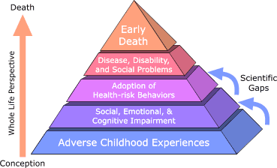
Toward a Trauma-Informed Approach
ACES
ACA
The Adverse Childhood Experiences Study (ACEs) of 17,000 people found that trauma increased risk of health, social and behavioral challenges in life. To identify your own risk factors, take the ACEs quiz below:
Adult Children of Alcoholics / Dysfunctional Families (ACA), one of the most powerful self-help support groups for coping with trauma, asks the following questions to help people identify if they have a history of childhood trauma.

Slide 30
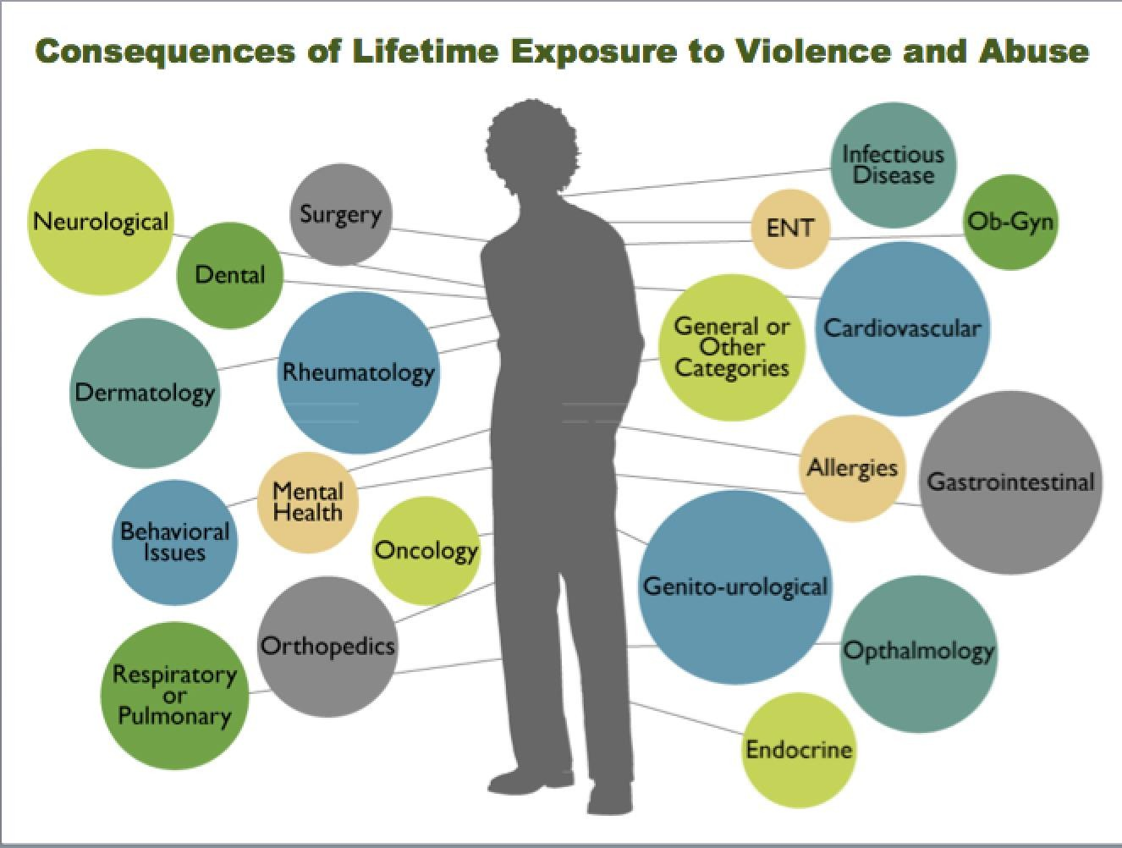
Consequences of Exposure to ACE Score of 4 and Above

Slide 31
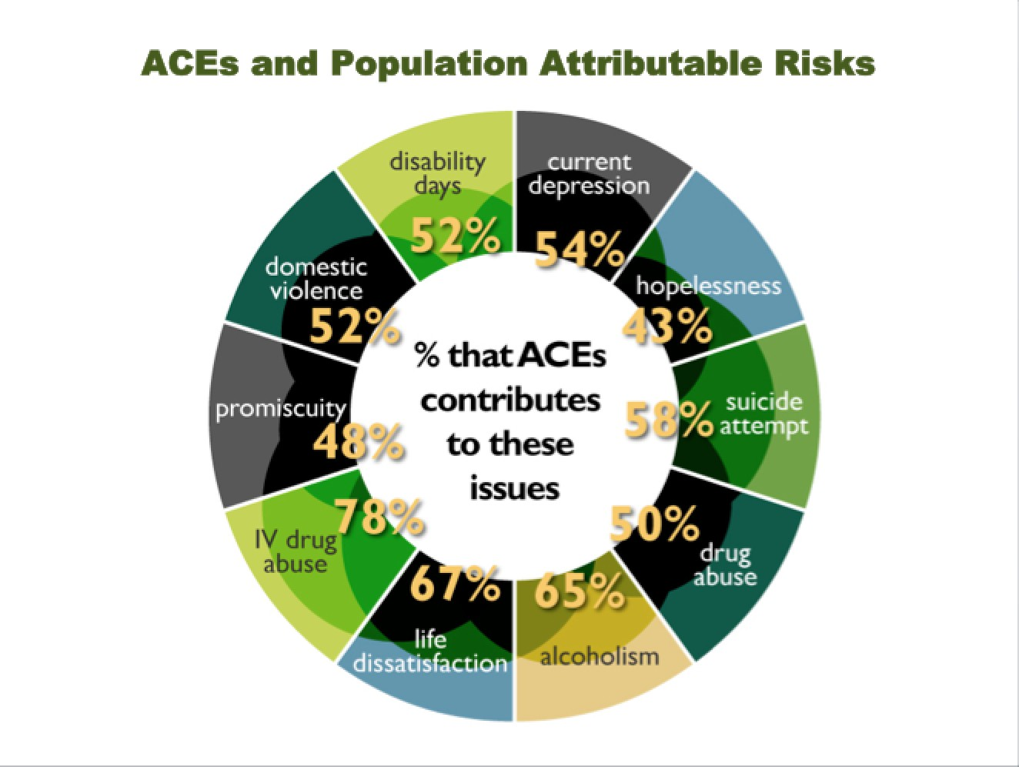
Risks Associated with ACE Score of 4 or More

Slide 32
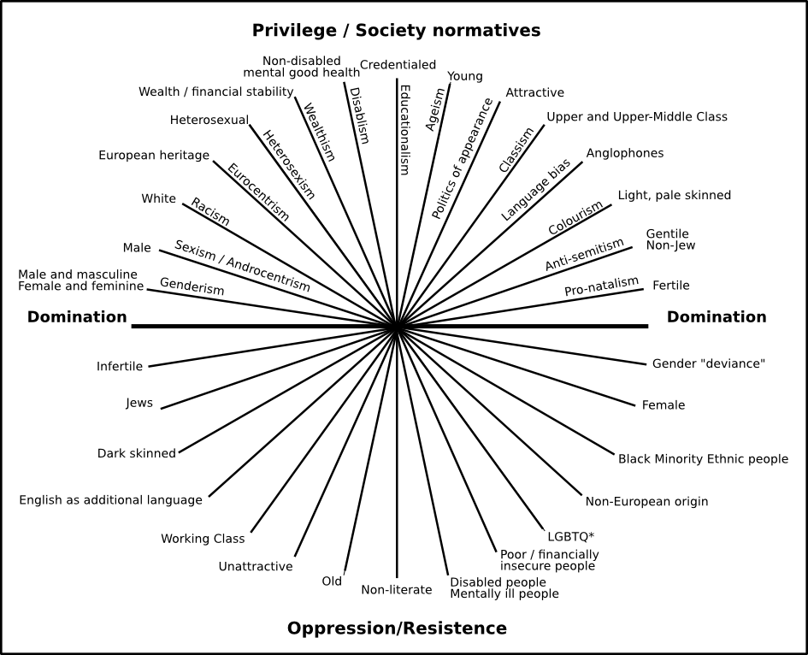
Intersecting Axes of Privilege, Domination and Oppression Adapted from Kathryn Pauly Morgan, “Describing the Emperor’s New Clothes: Three Myths of Educational (In)Equality” The Gender Question in Education: Theory, Pedagogy & Politics, Ann Diller et al., Boulder CO Westview, 1996.

Slide 33
Developmental Model in Supervision
Supervisees increase competence as they move through different stages and phases of development.
Competence and needs change over time.
Optimal supervision requires supervisors to attune themselves to the appropriate developmental stage of supervisee.
(NYC Health and Hospitals Corporation, 2013)

Slide 34
SUPERVISION
An important alliance
between two individuals
in differing roles
working towards
a common goal :
Increasing and incorporating self-awareness in service of supporting others

Slide 35
Developmental Model in Supervision
Awareness pertains to the peer supporter’s expansion from awareness of only the self to include awareness of person being served.
Motivation refers to moving through levels of confidence in skills application and role definition
Autonomy describes the transition from dependency on the supervisor to a consultative relationship

Slide 36
Recommended Practices:
Supervision of Peer Specialists
Administrative | Support | Educate | Advocate | Evaluate
Hire Peer Specialists who meet job qualifications | Build rapport by providing constructive feedback | Offer relevant training and conference attending opportunities | Build good morale and a respectful work environment | Conduct performance evaluations
Orient Peer Specialist to organizational structure | Use strength-based approach to help Peer Specialist problem-solve | Coach Peer Specialist on engaging people | Strengthen the discipline of Peer Support | Manage expectations of job performance
Help Peer Specialist understand practices and procedures | Promote wellness and self-care | Explain the big picture, put things in perspective and provide context | Negotiate reasonable work accommodations | Address areas needing improvement; progressive discipline

Slide 37
Stages of Development
LEVEL I | Transitioning | LEVEL II | Transitioning | LEVEL III
1.0 | 1.5 | 2.0 | 2.5 | 3.0
Limited self-awareness | Focus shifts to client and away from self | May become too enmeshed to be effective Issue is balance | More reactions of self to client | Accepts strengths and weaknesses
High motivation and anxiety | May reduce for new learning | More confident but can be shaken by complexity | Desire to personalize orientation | Concerned with professional identity and role
Dependent on supervisor and needs structure | May desire more autonomy than warranted | Dependency/ Autonomy conflict | More conditionally autonomous | Firm belief in own autonomy Senses when consultation is necessary
A
W
A
R
E
N
E
S
S
M
O
T
I
V
A
T
I
O
N
A
U
T
O
N
O
M
Y
Readiness tool developed by Jonathan Edwards and Gita Enders based on Stoltenberg & McNeill, 2011

Slide 38
Dialogue in a nutshell
Listen to learn
Speak to share from your own experience
The goal is to learn as much as possible from others
Ask questions

Slide 39
Debate | Dialogue
Assumes there is a right answer, and I have it | Assumes that many people have pieces of the answer, and that together they can craft a solution

Slide 40
Debate | Dialogue
Is combative—participants attempt to prove the other side is wrong | Is collaborative – participants work together toward common understanding.
It’s about winning | It’s about exploring common good
Entails listening to find flaws and make counter-arguments | Entails listening to understand, and find meaning and agreement
I defend my assumptions as truth | I reveal my assumptions for re-evaluation

Slide 41
Debate | Dialogue
I critique the other side’s position | I re-examine all positions
I defend my own views against those of others | I admit others’ thinking can improve my own
I search for weakness in other’s positions | I search for strength and value in others’ positions
I seek a conclusion or vote that ratifies my position | I discover new options

Slide 42
Behaviors that support dialogue
Suspension of judgement while listening and speaking.
Respect for differences
Role and status suspension
Balancing inquiry and advocacy
Focus on learning

Slide 43
Tools to be an ally
Get Ready
Identify the Behavior
Appeal to Principles
Set Limits
Find an Ally/ Be an Ally
Be Vigilant

Slide 44
Your Developmental Model in Action
Assessing Peer Support along High-Low Recovery Practices
Helper-Therapy
Peer Listening and disclosing
Recovery Planning
Self-Help Support Groups
Peer Bridging
Self-care
Incorporating Job-specific elements into Developmental Model
Job descriptions

Slide 45
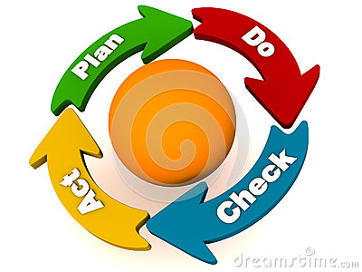
Kaizen Model for Continual Improvement
Incremental Change
Reinforced by Data
Applied Continually

Slide 46
Nationally-informed Trainings
Strategies for an Effective Peer Workforce--Dec. & Jan. 2019
Cultural Competency: Becoming an Ally—February 2019
Trauma-informed Developmental Model of Supervision—March 26, 27, 28 2019
Stigma… in Our Work and in Our Lives—April 29, 20 and May 1& 2 2019
Participants are encouraged to attend all trainings in person. Online versions will be available for those who miss the training.

Slide 47
Opportunities
Form an Implementation Team on the peer workforce at your agency
Sign up for a mentor.
Questions? training@shareselfhelp.org

Slide 48
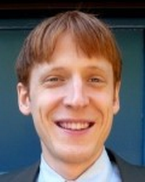
Evaluation
University of Texas professor Dr. Louis Brown will evaluate the effectiveness of the project in which 500 peers and supervisors from 89 sites are participating.
Louis.D.Brown@uth.tmc.edu

