Slide 1
Supervision and Co-Supervision for Family(Peer) Support Specialists
Notes:
Welcome and Introductions.

Slide 2
Goals For Today:
Understand
Understand how core competencies lead to effective supervision
Identify
Identify supervision types and reflect on current practices
Discuss
Discuss the Family Support Specialist Competency Assessment
Explore
Explore a co-supervision model that aligns with the culture of peer support

Slide 3
Rate Yourself on the quality of supervision you provide
What is the frequency?
Is it regular?
Is it private?
Is it emotionally safe?
Are you ‘present’?
How much time do you listen?
How much time do you talk?
Do you pose reflective questions?
Notes:
This is an activity. Ask participants to silently give themselves a number between 1-10 for each of these and just think privately about each one honestly.

Slide 4
Distinct Types of Supervision
Administrative Supervision:
Clinical Supervision:
Peer Supervision:
Reflective Supervision:
Notes:
Administrative Supervision: complying with contracts, approving time, vacation, staffing, policies compliance,
Clinical Supervision: identifying unmet needs, medication, diagnosis, clinical perspective, systems thinking
Peer Supervision: peer practice, boundaries and ethics, maintaining mutuality,
Reflective Supervision: relationship based, reflective function, mindfulness practice, feelings matter, forgiveness and acceptance, courageous,

Slide 5
Key functions and responsibilities of Supervision
Supporting
Supporting staff development
Building
Building a secure base
Maintaining
Maintaining ideals, standards, quality assurance and safety
Facilitating
Facilitating open communication and team functioning
Modeling
Modeling expectations

Slide 6
Core Elements of Supervision
Observation
Behavior (How is the person showing up?)
Knowledge/Skills (What does the employee know – Can they practice what they know?)
Practice (Is the employee learning to adapt their knowledge in new ways, are they getting better in applying new skills?)

Slide 7
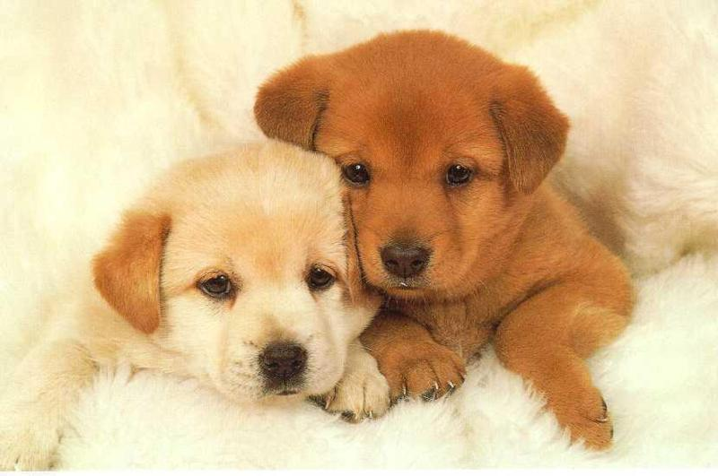
Core Elements of Supervision
Feedback
Does the employee receive information about how they are doing?
Do they know what their strengths and challenges are?
Do they know what can be done to address their challenges?

Slide 8
Core Elements of Supervision
Motivation
Ability to motivate staff to participate in increasing skills/practice
Ability to develop strong working relationships with employees
Ability to invite the employees thoughts/ideas into the process of supervision

Slide 9
Supervision for Family Support Specialists
What it is What it is not
A TIME TO REFLECT * Just listening
A SAFE PLACE * Occasional
RESPECTFUL * Therapy
REGULAR * For those less experienced
PREDICTABLE * Easily Done
PREPARED

Slide 10
Reflective Supervision
Core operating Principles
Regularity
Collaboration
Reflection
Feniche1992

Slide 11
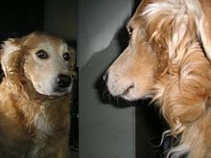
Reflective Supervision
Characteristics
Relationship based
Parallel process
Reflective function
Mindfulness practice
Feelings matter
Courage to face conflict (and skills to be ok with it)
Strength based
Forgiveness and acceptance (giving grace to ourselves and others)

Slide 12
Using Core competencies in Supervision
Assessing Work Expectations
Connecting Everyday Challenges to Competencies
Guiding Consistency of Practice
Elevating the Peer Practice to Fidelity
Expanding Shared Language

Slide 13
6 Competencies, 43 Core Areas

Slide 15
Family Support Competency Assessment
Notes:
Have each participant complete the self assessment. Set it up as a no fail, no shame experience but to get to know the competencies. Participants then get into pairs and discuss strengths that they found and any areas of concern or questions. This is not to go in depth in the competencies (there is another training for that) but to acknowledge that this is shared language and consistent competencies that help family support deepen the peer practice.

Slide 16
Why Competencies support Effective Supervision?
Fidelity Measurement
Identifies Strengths
Focus on Skills
Measures Strengths in Others
Identifies Areas for Growth

Slide 17
Co-Supervision

Slide 18
What is Co-Supervision?
When more than one (usually two) supervisors manage an employee or group of employees.
Requires collaborative partnership between supervisors.
Joint activities in co- supervision
Scheduling of hours
Project management
Observation of employee performance
Analyze and monitor practice
Performance Evaluation

Slide 19
Family Support Specialists (peer) come prepared to discuss their families, strengths and barriers they are having
Supervisor comes prepared to gain connection, understand their worldview, gain mutual responsibility to create plans that move towards success. Feedback about how to use their own story and journey in their peer work
Family Support Specialist (peer) drives the process – assuring that they get out of it what they need
Peer to Peer Supervision

Slide 20
Often used and recommended when peer positions are out-stationed or hired by a community agency/mental health organization other than the family organization
For Family Support Specialists (peer) that are providing Medicaid billing services they must be receiving clinical supervision as well
Valuable even when peer positions are hired and supervised by the family organization
Combined Clinical and Peer Supervision

Slide 21
BENEFITS OF CO-SUPERVISION
Opportunity for clinical partners to learn the benefits and challenges of peer delivered services
Sharing of knowledge , expertise and experience
Supports the process of sustaining high quality peer delivered services work in the clinical environment
Notes:
What the first session can look like…
The first dual supervision session
Everyone sits down at the table. Everyone looks at each other for a bit, not sure who is in charge, who is leading, each looking at each other.
“What do you want talk about?”
“Um, What am I doing here?”
“I have some experience, some good and some bad. Most of the time I have been on my own.”
“Well, we are going to do this supervision thing together and that’s how its going to be.”
Consider a Professional Service Agreement/Contract for Clinical Supervision when possible – It is important to find a Clinical Supervisor who understands and believes in the value of peer delivered services and a Peer Supervisor who understands systems issues and system perspectives. This doesn’t mean we don’t continue to inform, educate and push back, it means we seek to understand each other and continue to move forward together.
Consider the work we do and in particular this model of supervision to be a journey that we all go on together. This is an opportunity for continuing to understand each other and value each other. And in doing this, we have to be comfortable with feeling uncomfortable. When we can do this, that is where we have the opportunity to create an impact, to affect change… Take this back to your communities and really think about this statement… Be committed to seeing the value in developing a comfort with feeling uncomfortable.

Slide 22
What each person brings to
Co-supervision
Clinical Supervision is consultation that is primarily clinical and includes diagnostic impressions, intervention strategies, clinical guidance/advice
Peer Delivered Services Supervision is consultation that deepens the practice of peer support and addresses needs that maintain the practice

Slide 23
Oregon Family Support Network
4275 Commercial St., SE
Suite 180
Salem, Oregon 97302
Phone: 503-363-8068
Fax: 503-390-3161
Twitter: @OregonFSN
www.ofsn.org

