Slide 1
Evidence-based Peer Practices
Ruth Hollman
Founder & CEO, SHARE! the Self-Help And Recovery Exchange
Los Angeles, CA, USA

Slide 2
5 Evidence-based Peer Practices
Helper Therapy Principle
Listening and Disclosing
Recovery Planning
Self-help support groups
Peer Bridging

Slide 3
Outline of this Presentation
For each evidence-based practice I will:
Define it
Identify the key components of it
Present evidence to support it
Give supervisors a key question to ask to easily identify if the practice is being implemented
Give examples of high implementation and low implementation of the practice

Slide 4
The Helper Therapy Principle
Evidence-Based Peer Services

Slide 5
The Helper-Therapy Principle
States that the person who helps gets more out of the interaction that the person being helped
Peers give the people they serve opportunities to help others, so they get the benefits of helping
Helping others has positive health and mental health benefits—and heals the Helper more than the person being helped
Creating opportunities for people to help improves their health, mental health and self-esteem

Slide 6
The Helper-Therapy Principle Key Component
When people help others, or even perceive they are helping others, they feel good about themselves in ways that improve their mental health, health and functioning.

Slide 7
Helper-Therapy Principle Evidence
Among teens tutoring younger children, the younger children’s grades improved with tutoring, but the teen tutors’ grades improved even more. (Rogeness & Badner, 1973)
A majority of Community Health Workers felt helper benefits including positive feelings about self, a sense of belonging, and valuable work experience (Roman, L.A. et al 2002)
Recovery rates for alcoholics doubled if they were helping other alcoholics (Post, S.G. 2008)

Slide 8
Helper-Therapy Principle Evidence
The “helper’s high:” Helpers report a distinct physical sensation associated with helping. About half report that they experienced a "high" feeling, 43 percent felt stronger and more energetic, 28 percent felt warm, 22 percent felt calmer and less depressed, 21 percent experienced greater feelings of self-worth, and 13 percent experienced fewer aches and pains. (Luks, 1988)

Slide 9
The Helper-Therapy Principle Key Question
Is the peer letting the person help them, or encouraging them to help others?
By asking the Key Question, supervisors can get peers to better practice the Helper Therapy Principle.

Slide 10
Effective ingredients of The Helper-Therapy Principle
Creating leadership opportunities
High implementation | Low implementation
Peer worker is adept at creating opportunities for people to be the person helping. For example, finding a skill that someone has and having them teach that skill to others; teaching the person to use Word today and having them train someone else in Word tomorrow; volunteering in the community; going to self-help support groups. | Peer worker lacks structure and approach to create leadership opportunities. Peer worker does projects and accomplishes things themselves, rather than giving others the satisfaction of being leaders and making a difference.

Slide 11
Effective ingredients of The Helper-Therapy Principle
Empowering others
High implementation | Low implementation
Peer worker listens for and implements participants’ suggestions such as having a Kwanzaa celebration, writing their legislative representative about something they want changed, starting their own business, putting on a program, inviting people to a recovery panel, etc. The Peer worker lets the person help them. | The only opportunities to help are those created by staff and/or directed by staff. The Peer worker sees their role as helping the person and rarely lets the person help them.

Slide 12
Peer Listening & Disclosing
Evidence-Based Peer Services

Slide 13
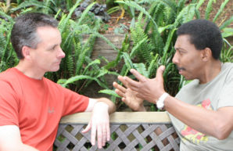
Peer Listening and Disclosing
Definition: Peer listening and disclosing is using active-listening techniques and sharing one’s own lived experience of the situation a person is going through
Peers do not give suggestions or advice unless specifically asked for it
Peer listening and disclosing is different from and complementary to clinical expertise because it represents a relationship of equals in which each is benefiting from the relationship with the other

Slide 14
Peer Listening and Disclosing Key Components
Peers help others with similar challenges by understanding and sharing their own experience with “I” statements
Peers listen fully the whole time the person is talking without thinking about what they might say in response
Only after the person stops talking does the Peer respond. It is OK to have a few seconds of silence to gather thoughts
Peers disclose only those parts of their stories that speak directly to what the person has shared

Slide 15
“A key to unlock themselves.”
Click for video (32 sec)

Slide 16
Peer Listening and Disclosing Evidence
Increased:
Self-esteem and confidence
Feeling of control and ability to make life changes
Sense of hope and inspiration
Empathy and acceptance
Engagement in self-care and wellness
Social Support
Social functioning
Empowerment scores
Sense that treatment is responsive and inclusive of needs
https://www.samhsa.gov/sites/default/files/programs_campaigns/brss_tacs/value-of-peers-2017.pdf

Slide 17
Peer Listening and Disclosing Key Question
Is the Peer Specialist’s listening free from judgement or suggestion? Are they regularly sharing their own similar experiences in such a way that the person being supported feels connection and hope and is empowered to experience growth and change?
By asking the Key Question, peers can better practice Peer Listening and Disclosing.

Slide 18
Effective ingredients of Peer Listening and Disclosing
Disclosing for the person
High implementation | Low implementation
Peer worker discloses their own experience with similar issues, including how they felt, what they thought at the time and what worked and did not work, without being asked. They use “I” statements in disclosing. | Peer worker discloses only when asked and does not include their feelings or thoughts at the time. They express their experience in the form of advice or say things such as “You should do what I did.”

Slide 19
Effective ingredients of Peer Listening and Disclosing
Disclosing reality
High implementation | Low implementation
The Peer worker discloses both their successes and challenges, including current challenges that they are encountering in their recovery that relate to what the person is going thru. | The Peer worker only discloses their successes and appears to be perfectly recovered without any problems. They hide their own setbacks from the people they are serving.

Slide 20
Effective ingredients of Peer Listening and Disclosing
Peer to peer
High implementation | Low Implementation
Peer worker is open about their lived experience, treats the person being served as an equal and uses peer boundaries. The Peer worker concentrates on connecting the person to non-paid social supports in the community. | Peer worker provides support using a clinical approach and/or clinical boundaries. The person’s social network is limited to professional relationships and other people at the clinic.

Slide 21
Recovery Planning
Evidence-Based Peer Services

Slide 22
Recovery Planning Definition
Recovery Planning is a way for a person to take charge of and control their recovery process by developing a written plan to help in their recovery.
Two main Recovery Planning tools:
Wellness Recovery Action Plan® or WRAP®
SHARE! Plan for Success

Slide 23
Wellness Recovery Action Plan® (WRAP)
“…is a self-designed prevention and wellness process that anyone can use to get well, stay well and make their life the way they want it to be.” (mentalhealthrecovery.com/wrap-is/)

Slide 24
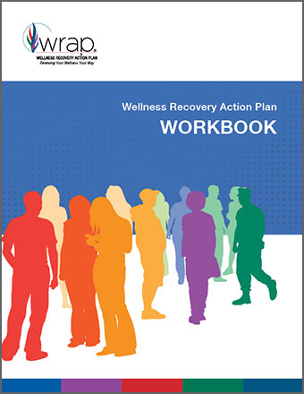
Effectiveness of WRAP®
WRAP has been linked to significant improvements in self-reported symptoms, recovery, hopefulness, self-advocacy and physical health (Cook et al, 2009; Copeland et al, 2012).
WRAP was listed on the SAMHSA National Registry of evidence-based programs and practices, because of research showing it works

Slide 25
SHARE! Plan for Success
Creates a pathway from today to success in 5 years using Backwards Design
In Backwards Design, you start where you want to be in the future, five years from now and work backwards to get to where you are today
Backwards Design is an evidence-based best practice that is effective in helping people achieve their goals faster (Wiggins & McTighe, 1998).

Slide 26
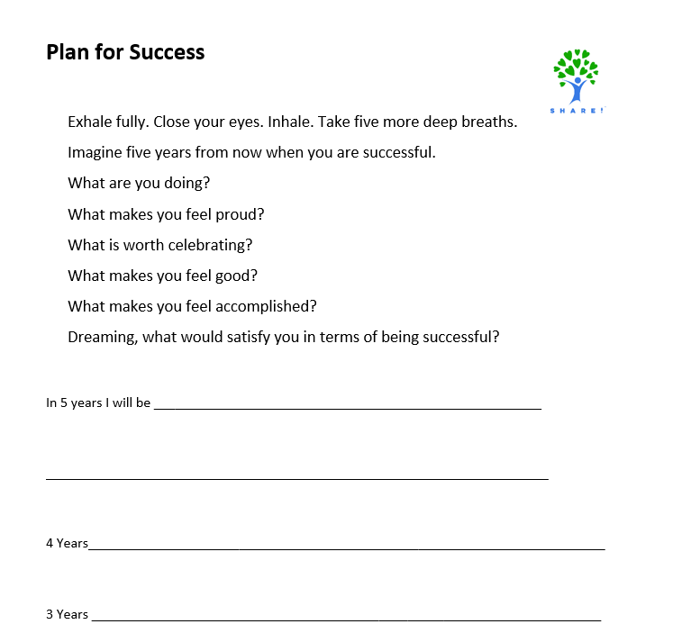
SHARE! Plan for Success
Discover what successful you will be doing in 5 years
Then write it down on the Plan for Success worksheet

Slide 27
SHARE! Plan for Success example
5 years—Living in Hawaii in a beach house that I own working as a Real Estate Agent.
4 years—Sell houses in Hawaii, saving all my commissions, sell my condo and buy a beach house
3 years— Move to Hawaii with all my savings. Buy a cheap condo to live in. Get Hawaiian Real Estate license and start selling houses.
2 years—Sell 20 houses in Los Angeles. Save as much as I can.
1 year-- Get a job at a real estate agency and begin selling houses, saving every penny I can.
9 months—Take the California Real Estate Exam
6 months—get a supervising Real Estate Broker to sponsor me for my Real Estate License
3 months—Finish Real Estate school
2 months—Research Real Estate Brokers to find ones likely to sponsor me
1 month— Continue at Real Estate school
2 weeks-- Start Real Estate school
1 week—Fill out and submit Real Estate school application
Tomorrow—Get all the documentation needed for Real Estate school application
Today—Research Real Estate Schools in Los Angeles and pick one to apply to.

Slide 28
SHARE! Plan for Success--Commitments
Once the plan is developed, daily, weekly or monthly commitments are made to a friend, Peer Worker, Case Manager or written down.
There is no consequence for not keeping a commitment, but lots of praise for the progress
Reframe attempts that did not work as learning opportunities rather than failures
Most people achieve their 5-year success in two to three years

Slide 29
Effective ingredients of Recovery Planning
Modeling success
High implementation | Low implementation
Peer worker shows their own WRAP and Plan for Success, with their goals and commitments and talks about how it has helped them. They also talk about things that did not work out as planned and how they coped. | Peer worker gives someone the forms to use in recovery planning. Peer does not disclose their own recovery planning process or difficulties they had to overcome or are still working to overcome.

Slide 30
Effective ingredients of Recovery Planning
Support
High implementation | Low implementation
The Peer worker encourages the person to be ambitious and accepts the goals that the person wants to work on, even if they appear to be unrealistic. | The Peer worker tries to make sure that the person’s goals are easily achievable and realistic to where they are now.

Slide 31
Effective ingredients of Recovery Planning
Autonomy
High implementation | Low implementation
Peer worker supports the person in starting anywhere to reach their goals. | Peer worker suggests what the next step toward the person’s goals should be.

Slide 32
Self-Help Support Groups
Evidence-Based Peer Services

Slide 33
Self-Help Support Groups Definition
The American Psychological Association defines a self-help support group as: “A voluntary, self-determining, and non-profit gathering of people who share a condition or status; members share mutual support and experiential knowledge to improve persons’ experiences of the common situation.”

Slide 34
Self-Help Support Groups Key Components
Everyone in the group is an equal
Sharing and/or interaction between members
Decisions are made by the group members
Leadership is shared or rotated
Groups often use a written document called a “format” to explain the rules of the meeting at each session
Safety and anonymity are protected

Slide 35
Research: Self-Help Support Groups
Cut the rehospitalization of mental health consumers by 50 percent
Reduce the number of days spent in the hospital by one third
Reduce significantly the amount of medication needed to treat mental health issues
Move large numbers of people out of the system into productive lives
Participants are more likely to collaborate with clinical staff regarding taking medications
Effects are realized in weeks and sustained for years
Reduce drug and alcohol abuse
Reduce demands on clinicians’ time
Increase empowerment
Provide community support—the suspected reason that people in developing countries recover from schizophrenia at nearly twice the rate that they do in developed countries
Provide mentoring opportunities that improve the outcomes of both the mentor and the person being mentored
Reduce criminal behavior
Increase family resources and reduce family stress
Increase consumer satisfaction
Are underutilized by clinicians because of incorrect preconceived ideas about self-help and the lack of professional training on self-help

Slide 36
Self-Help Support Groups Key Question
Key Question: Is the Peer Specialist attending self-help support groups and using their lived experience with them to give the benefits of them to others?
By asking the Key Question, peers can better incorporate self-help support groups in supporting others.

Slide 37
Self-Help Support Groups: Different strokes for different folks

Slide 38
Self-help support groups
More than 12,000 groups in Los Angeles County alone with 750 different focuses
Work best when the worldview of the person is matched with a group with similar worldview
For example: groups for substance abuse recovery: 12-Step programs for people with belief in a single god; SOS for agnostics & atheists; SMART Recovery for people who do not want to share their personal business in public; Free N One for evangelical African Americans
No need to make an appointment or call beforehand. In most groups, people just show up at the day and time of the meeting either in person or online.
Groups have tools that help members change and grow
Available in many languages and easy to start for a new language
Most groups ask for a small donation ($1 to $5), but no one is turned away for lack of funds
Try a group six times before you decide if it is working for you
Call 1-877-SHARE-49 to find the best self-help support group fit or for help starting meetings

Slide 39
Effective ingredients of Self-Help Support Groups
Equal relationships
High implementation | Low implementation
Peers with the same level of power—none of whom are paid—attend a support group addressing a common concern. Leadership and decision-making are provided by the members. | Paid peer specialist leads the support group and discussions, addresses disruptive behavior and makes decisions for the group.

Slide 40
Effective ingredients of Self-Help Support Groups
Community-based
High implementation | Low implementation
Referrals and information about community-based self-help support groups are available to all participants. | Groups are held only at a mental health facility and/or are canceled when the room is needed for other uses.

Slide 41
Effective ingredients of Self-Help Support Groups
Safety
High implementation | Low implementation
Crosstalk, where others interrupt or comment on someone’s sharing, is not allowed and is enforced by any member of the group with gentle reminders. Anonymity is expected and protected. | The leader has the right to ask anyone to leave without hearing their side of the issue or giving them opportunities to improve. People who are not peer members of the group enter the group without the group’s permission. Staff create clinical notes about what happens in the group identifying individuals. Members sign in.

Slide 42
Effective ingredients of Self-Help Support Groups
Due process
High implementation | Low implementation
Each person has a right to due process in the group and is given opportunities to change disruptive behavior before the group takes action to exclude the member. If someone is asked to leave, it is for only one or two meetings, not forever. | Disruptive people are banned from attending the group without being given a chance to change their behavior.

Slide 43
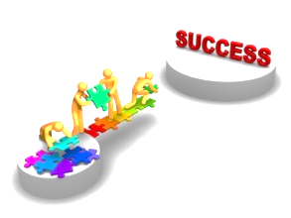
Peer Bridging
Evidence-Based Peer Services

Slide 44
Peer Bridging Definition
Peer Bridging is “supporting a person in moving from one situation to another by a Peer with similar experience”
Examples of Peer Bridging:
inpatient => outpatient
homeless => housed
inmate => community

Slide 45
Peer Bridging Key Components
Peer Bridgers:
Ideally get to know the person they are bridging before they are in their new situation
Normalize people’s fears, concerns and feelings by disclosing their similar lived experiences
Connect people to self-help support groups
Use Recovery Planning to empower the person to move forward
Use the Helper Therapy Principle—finding situations where the person being served is the one providing the help
Serve as a support and role model

Slide 46
Peer Bridging Evidence
Peer Bridgers:
Reduce rehospitalization by 50 percent
Reduce psychiatric ER use in favor of outpatient services
Succeed in getting 60 percent of people going to self-help support groups which reduce costs of treatment, increase employment, reduce drug & alcohol abuse, etc.

Slide 47
Peer Bridging Key Question
Is the Peer Bridger empowering the person served and walking together as the person makes their own decisions in moving from one situation to another, using the Helper Therapy Principle, Listening and Disclosing, Recovery Planning and Self-Help Support Groups?
By asking the Key Question, peers can better practice Peer Bridging.

Slide 48
Effective ingredients of Peer Bridging
Integrating Support
High implementation | Low implementation
Peer worker integrates the practical parts of the change with their own experience with a similar change including their feelings, hopes, fears, challenges, etc. They respect the feelings, fears, etc. of the person being served. | Peer worker sees that the practical parts of the change are taken care of. The Peer worker does not connect with the person regarding their feelings, hopes, fears, and apprehensions. They reassure with little or no disclosing.

Slide 49
Effective ingredients of Peer Bridging
Respecting Differences
High implementation | Low implementation
Peer worker recognizes the individuality of the person they are working with and supports them where they are, even when they have different assessments of the situation and/or different perspectives or worldviews. They recognize that everyone has a different recovery journey. One size does not fit all. | Peer worker expects that the person they are working with has the same worldview as they do, and thus will handle the situation in a prescribed way. They may assume that people need the same recovery tools that the peer worker has used. They judge the person served as “wrong” rather than as a human being able to make the best decisions for themselves.

Slide 50
Effective ingredients of Peer Bridging
Peer Role
High implementation | Low implementation
The Peer worker see their primary role as helping someone discover their own path to recovery, including setting their own, goals, deciding what is important to them, and connecting the person to non-paid social support in the community. | The Peer Worker sees their primary role as solving the person’s problems and connecting them to other professional services.

Slide 51
Effective ingredients of Peer Bridging
Relationship building
High implementation | Low implementation
The Peer worker prioritizes the relationship with the person they are working with. Other issues are secondary. For example, the Peer worker starts the session together with a check in as to how things are going, including a short honest update on their own recovery before moving other issues and paperwork. | The Peer worker is all business and struggles to build an authentic relationship with the person. Their focus is on checking off everything they need to get done with the person that day.

Slide 52
Questions and Answers

Slide 53
Thank you!

