Slide 1
An Introduction to the Recovery International CBT self-help mental health support Method
Holly Weiss
NY State Certified Peer Specialist
Recovery International NY City Area Team Leader,
Outreach and Programming Committees
© Recovery International

Slide 2
Introductions
© Recovery International

Slide 3
About Recovery International
Founded in 1937 by neuropsychiatrist Dr. Abraham Low
Developed over 80 years ago by Dr. Low and his patients
Foundation of Cognitive Behavioral Training
Consistent approach replicated by nonprofessionals = peer-led, self-help model
Group meetings: in-person, online Zoom, phone, chat
© Recovery International

Slide 4
Meetings and practice for anyone, anywhere, anytime
In-person Community meetings ( subject to pandemic guidelines)
Zoom
Phone
Chat
Facebook closed page
Veterans
Youth
© Recovery International
Notes:
Lisa

Slide 5
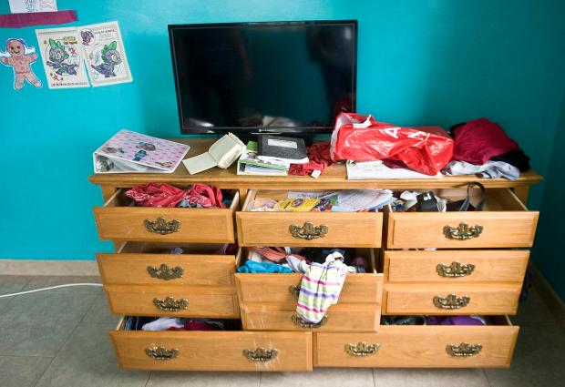
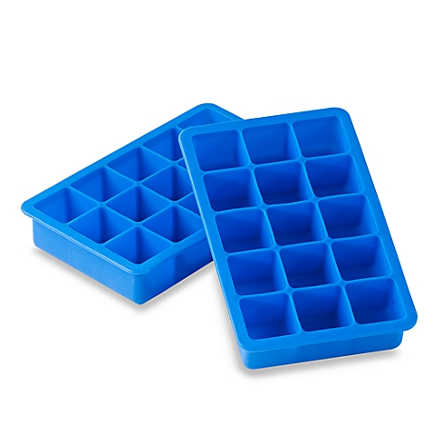
Focus on trivialities
We only deal with symptoms experienced during the trivialities of everyday life:
obstacles
delays
inconsiderate people
frequent annoyances, irritations and frustrations
fear
anger
lowered feelings
anxiety
obsessive-compulsive behavior
insomnia
and more!
© Recovery International

Slide 6
Basic Concept # 1: 2 types of Temper
The judgment of right and wrong in everyday events.
(This does not apply to legal, moral, or ethical issues.)
ANGRY TEMPER
(The other person is wrong, or has wronged me)
Feelings related to Angry Temper:
Resentment
Impatience
Hatred
Disgust
Rebellion
I don’t like it or want it; it shouldn’t be
Irritation
FEARFUL TEMPER
(I am wrong)
Feelings related to Fearful Temper:
Worry
Preoccupation
Feelings of inadequacy
Hopelessness
Fear of damage to yourself or your reputation
Sense of shame
Guilt / self-blame
Self-pity
© Recovery International
Notes:
Steve

Slide 7
Basic Concept # 2: Inner & Outer Environment and the 4-part experience (feelings, sensations, thoughts, impulses)
You CAN Control
Thoughts
Impulses
You CAN’T Control
Feelings
Sensations
DON’T ATTACH DANGER
Inner (Internal)
Everything Inside Your Skin
Outer (External)
Everything Outside Your Skin
Ideas produced by thinking, such as, “This is fun,” “I can do this,” “He is annoying,” and so on. You can learn to change your thoughts.
Emotions such as anger, impatience, hatred, fear, worry, embarrassment, shame and many more. You cannot control your feelings.
What you first want to do, such as to punch, to run, to hug, to laugh, to yell, and so on. You can learn to control your impulses.
Physical responses such as blushing, racing heartbeat, tense muscles, teary eyes, and many more. You cannot control these sensations.
© Recovery International
Notes:
Steve

Slide 8
Peer-led Meeting Format
Meeting Start-Up
Welcome
Reading of Dr. Low’s “Mental Health Through Will Training” or other
Introductions
Education and Practice
The Example Period (4-step CBT Method)
Group “spotting” and “highlights” on examples
Mutual Aid
Informal discussion
Questions
© Recovery International

Slide 9
The Recovery 4-Step Method
Step 4
Describe the Outcome
What would have happened before your Recovery training? What was the outcome this time? Report your progress.
Step 4
Describe the Outcome
Step 4: Success
Step 3
Spot the Temper
What kind of temper did you experience (fearful/angry)? What Recovery International tools/spottings did you use to calm yourself? Did you endorse for the effort?
Step 3: Spotting
Step 3
Spot the Temper
Step 2: Symptoms
Step 2
Describe the Symptoms
Report your physical symptoms and racing thoughts. What were your feelings/emotions?
Step 2
Describe the Symptoms
Step 1: Situation / Event
Describe an everyday event when you got worked up. What triggered temper and symptoms? Stick to the facts. Remove the emotion.
Step 1
Describe the Event
Step 1
Describe the Event
© Recovery International
Notes:
Steve

Slide 10
4-Step Method
Step 1. Report a single situation or event that occurred -- an everyday event when you began to work yourself up. Focus on a brief description of what happened: specifically, what triggered temper and symptoms?
Step 2. Report the symptoms you experienced -- both physical and mental (for instance, angry and fearful thoughts, confusion, palpitations, disturbing impulses, tightness in your chest, lowered feelings, sweaty palms, and so on.)
Step 3. Report your spotting of fearful and angry temper, the Recovery International tools you used to help yourself, and your self-endorsement for your effort(s).
Step 4. Begin with “Before I had my Recovery training,” and describe the temperamental reaction and symptoms you would have experienced in former days. What would have happened then verses what happened now? (This will help you to note the progress you have made.)
Step 4
Describe the Outcome
Step 4
Describe the Outcome
Step 3
Spot the Temper
Step 3
Spot the Temper
Step 2
Describe the Symptoms
Step 2
Describe the Symptoms
Step 1
Describe the Event
Step 1
Describe the Event
© Recovery International
Notes:
Lisa

Slide 11
Common Tools or “Spottings”
Treat mental health as a business and not as a game.
Humor is our best friend, temper is our worst enemy.
If you can't change a situation, you can change your attitude toward it.
Be self-led, not symptom-led.
Nervous symptoms and sensations are distressing but not dangerous.
Temper is, among other things, blindness to the other side of the story.
Comfort is a want, not a need.
There is no right or wrong in the trivialities of everyday life.
Calm begets calm, temper begets temper.
Don't take our own dear selves too seriously.
Feelings should be expressed and temper suppressed.
Helplessness is not hopelessness.
Some people have a passion for self-distrust.
Temper maintains and intensifies symptoms.
Do things in part acts.
Endorse yourself for the effort, not only for the performance.
© Recovery International

Slide 12
More Tools or “Spottings”
Have the courage to make a mistake, if indeed it was a mistake.
Feelings are not facts.
Do the things you fear and hate to do.
Fear is a belief –– beliefs can be changed.
Every act of self-control leads to a sense of self-respect.
Decide, plan and act.
Any decision will steady you.
Anticipation is often worse than realization.
Replace an insecure thought with a secure thought.
Bear the discomfort in order to gain comfort.
Hurt feelings are just beliefs not shared.
Self-appointed expectations lead to self-induced frustrations.
People do things that annoy us, not necessarily to annoy us.
Knowledge teaches you what to do, practice tells you how to do it.
Muscles can be commanded to do what one fears to do.
Tempers are frequently uncontrolled, but not uncontrollable.
© Recovery International

Slide 13
Example Highlights (Review)
1. Angry Temper - negative judgments (resentment, impatience, indignation, disgust, hatred) directed against another person or situation.
2. Fearful Temper - negative judgments (discouragement, preoccupation, embarrassment, worry, hopelessness, despair, sense of shame, feelings of inadequacy) directed against oneself.
3. Muscle Control - controlling the impulse to do something that would be detrimental for our mental health (example: controlling our speech muscles).
4. Muscle Movement - commanding the muscles to do something that we are resistant to do (example: attending an R.I. meeting when we'd rather stay at home or in bed).
5. Sabotage - when we ignore or choose not to practice what we have learned in R.I.; when we do not do what is best for our mental health. (example: not endorsing ourselves).
Step 4
Describe the Outcome
Step 2
Describe the Symptoms
Step 1
Describe the Event
© Recovery International

Slide 14
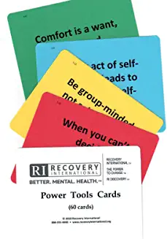
Reference Materials
Dr. Abraham Low’s books:
Mental Health Through Will-Training (Low, 1950)
Manage Your Fears, Manage Your Anger (Low, 1950)
Selections from Dr. Low’s Works (Low, 1966)
Peace vs. Power in the Family (Low, 1967)
The Wisdom of Dr. Low (1971)
RI Discovery workbook
Power Tools Cards
Power Your Mind: Tools to Build Resistance (youth/young adult workbook)
Notes:
Lisa

Slide 15
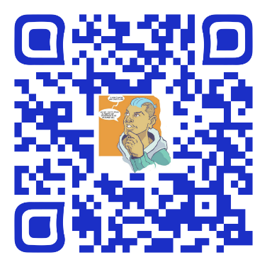
Simplified program for youth / young adults
Ages 13-24
graphic novel storytelling for group or individualized study
The program offers life skills to:
control anger
alleviate anxiety
develop and maintain peaceful relationships at home, school or work
establish realistic expectations and beliefs
www.poweryourmind.org
© Recovery International

Slide 16
Thank You!
FOR FURTHER INFORMATION:
www.recoveryinternational.org
Cognitive-behavioral self-help and peer-led programs
for more than 80 years.
© Recovery International

