Slide 1
Ensuring Quality: Using Customer Evaluations in Peer Co-Reflection Supervision Ann Kasper, MA, CPSS, BD ann@empowermentroots.com www.choiceheals.com www.kasperconnects.com

Slide 2
Please type in the chat: 1. Your Name 2. Location 3. Identify as a Supervisor/Peer/Other 4. Identify as a cat, dog or snake person today?
*

Slide 3
Today’s Topics: 1. Co-Refleciton Supervision 2. Peer Customer Evaluations
Yay!

Slide 4
“Out beyond the ideas of wrong-doing and right-doing, there is a field. I’ll meet you there. When the soul lies down in that grass. the world is too full to talk about.”
- Rumi, 1207-1273, Persian Poet

Slide 5
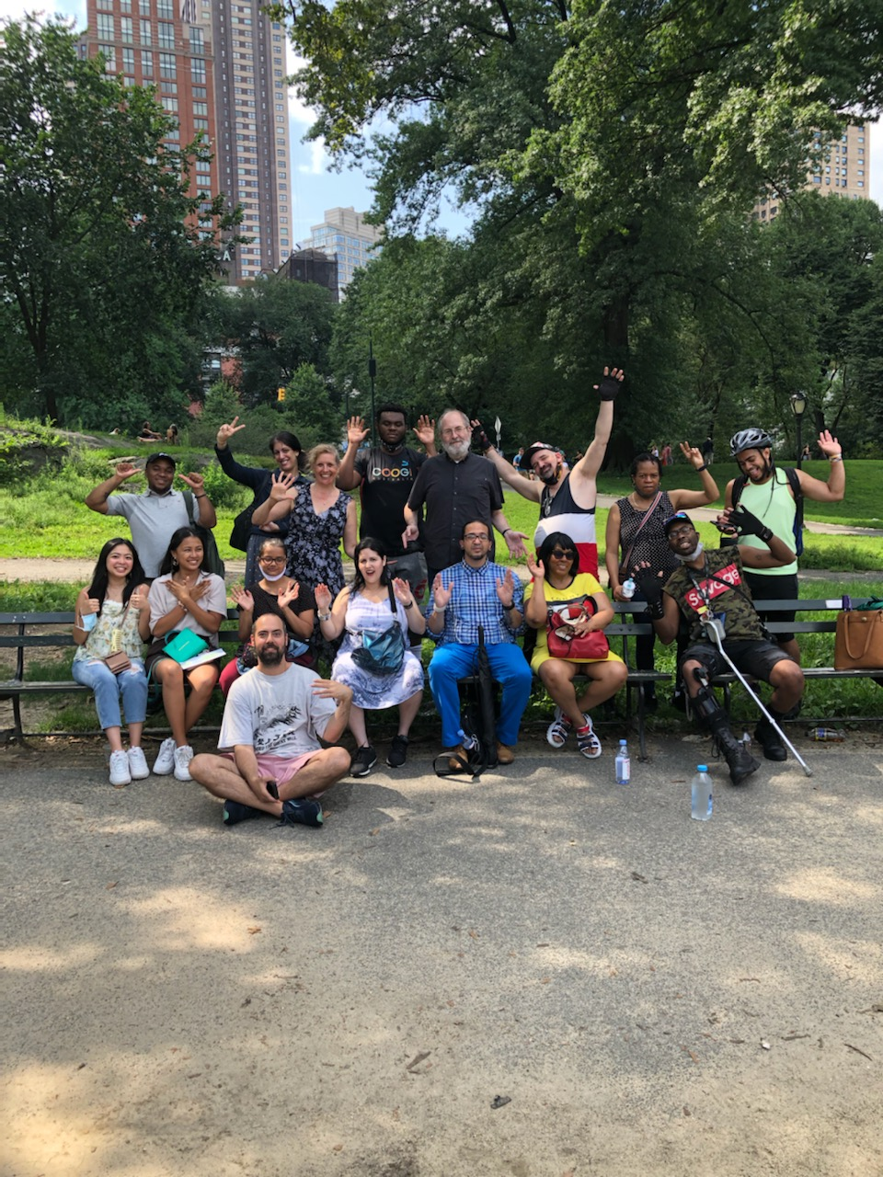
Hello!
I am Ann Kasper
I am here because I am team member building systems, a peer support specialist, and a service-user.
A person with lived and loved experiences.
Ann Kasper, MA, CPSS, BD
ann@empowermentroots.com
www.choiceheals.com www.vimeo.com/mentalhealthfreedom

Slide 6
I love traveling and international exchange! Do you?
Find more maps at slidescarnival.com/extra-free-resources-icons-and-maps

Slide 7
\ Thank you to 1. Oregon Senior Peer Outreach 2. Lori Franke, Sharon Kheun, Todd Trautner, Kimberly Lindsay
Yay!

Slide 8
How are you doing? a 😸 b 💑 c 😭 d 😒 e please type in the chat
*

Slide 9
“Healing is an inside job.”
Ann Kasper, MA, PSS, BD

Slide 10
For this Session: -Your (volunteer) roles: *Choose to talk in the small group breakout discussions, someone to take notes *Participate on the chat *Particpate in the group discussions *Stay awake

Slide 11
Today’s Topics: 1. Co-Refleciton Supervision 2. Peer Customer Evaluations
Yay!

Slide 12
Small Groups Now 1. Name 2. What you hope to gain from this session 3. Favorite dessert
*

Slide 13
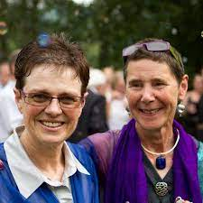
Intentional Peer Support Shery Mead and Chris Hansen
www.intentionalpeersupport.org
YouTube: Intentional Peer Support

Slide 14
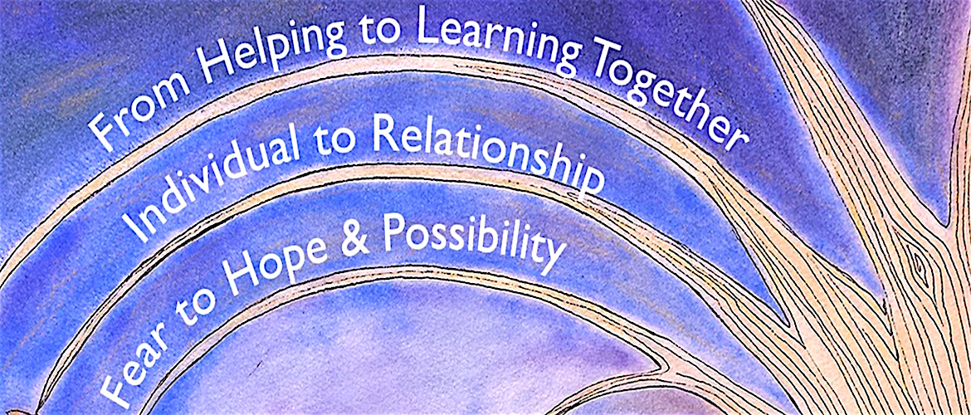
What is Intentional Peer Support?
www.intentionalpeersupport.org

Slide 15
What is Intentional Peer Support?

Slide 16
What is Intentional Peer Support?
Relationship First connection
***worldview*** 🌏
mutuality
moving towards

Slide 17
What is Intentional Peer Support?
Be Curious
Ask Open-Ended Questions

Slide 18
Intentional Peer Support-Open the Story
I wonder..
Help me understand …
What makes that so…
If you could have what you want, what would that be?
What can we do to get there?

Slide 19
What is Co-Reflection Peer Support Style Supervision?
Co-Creating
Mutual with Boundaries
Finding Meaning and Solutions Together

Slide 20
Question for You All
What do your supervisors do if there is a problem with the peer service? \
For supervisors: How do handle customer complaints with your peer supporters?

Slide 21
Healing-Informed Approach
- Ann Kasper

Slide 22
Peer Support Evaluation Have you ever received “bad” peer services yourself? What happened? Could you give feedback about it?
*

Slide 23
Question for You All
How do you currently get information on the quality of the peer support your program offers?

Slide 24
Oregon Senior Peer Outreach
Check on
Life Satisfaction
Loneliness
Program Entry and Exit
Looking for:
Are there changes in loneliness?
Are there reductions in emergency service usage?

Slide 25
Oregon Senior Peer Outreach
Loneliness Measures:
Health and Retirement Study (HRS)
http://hrsonline.isr.umich.edu
*

Slide 26
Oregon Senior Peer Outreach Surveys
Intentional Peer Support Competencies Scale
Disagree
Neither Agree of Disagree
Agree
Strongly Agree
Some of the statements include:
-I feel like the peer support specialsit and I are building a real connection.
-Conversations with the peer support specialist leave me hopeful.

Slide 27
Let’s Co-Create: How to create and conduct a customer evaluation survey for peers
1. What are the values of the program?
4. Have an independent surveyer if possible
2. What are the values of the peers?
S
5. Think about most comfortable methods to collect information
3. What are the values of the funders and future funders?
6. Measure and compare results over time

Slide 28
Timing of the Surveys
Too much is not a good thing in this case.

Slide 29
Question for You All
How do you currently bring information or feedback of the peer support to your peer supporters?

Slide 30
Breakout Small Group Session
Goals:
To get to know some other participants around the country and their favorite desserts
To come up with some evaluation questions or points of customer review for your program
Bring some suggestions back to the large group

Slide 31
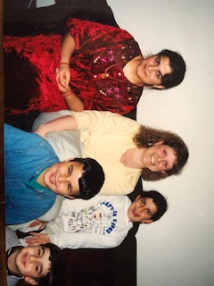
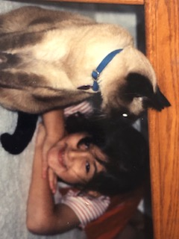
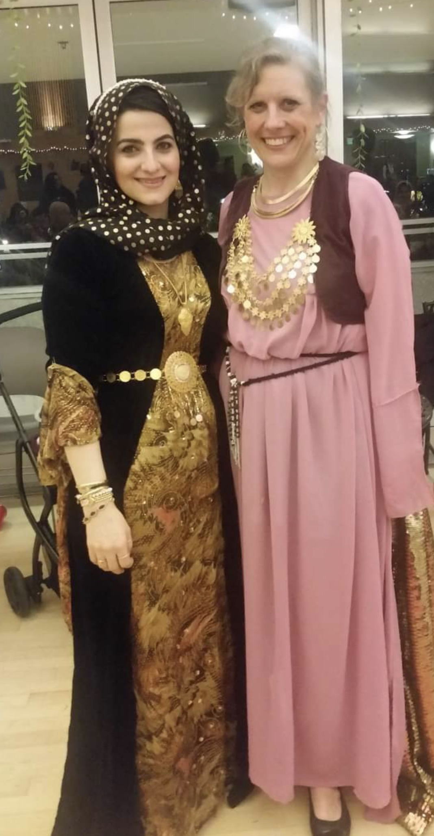
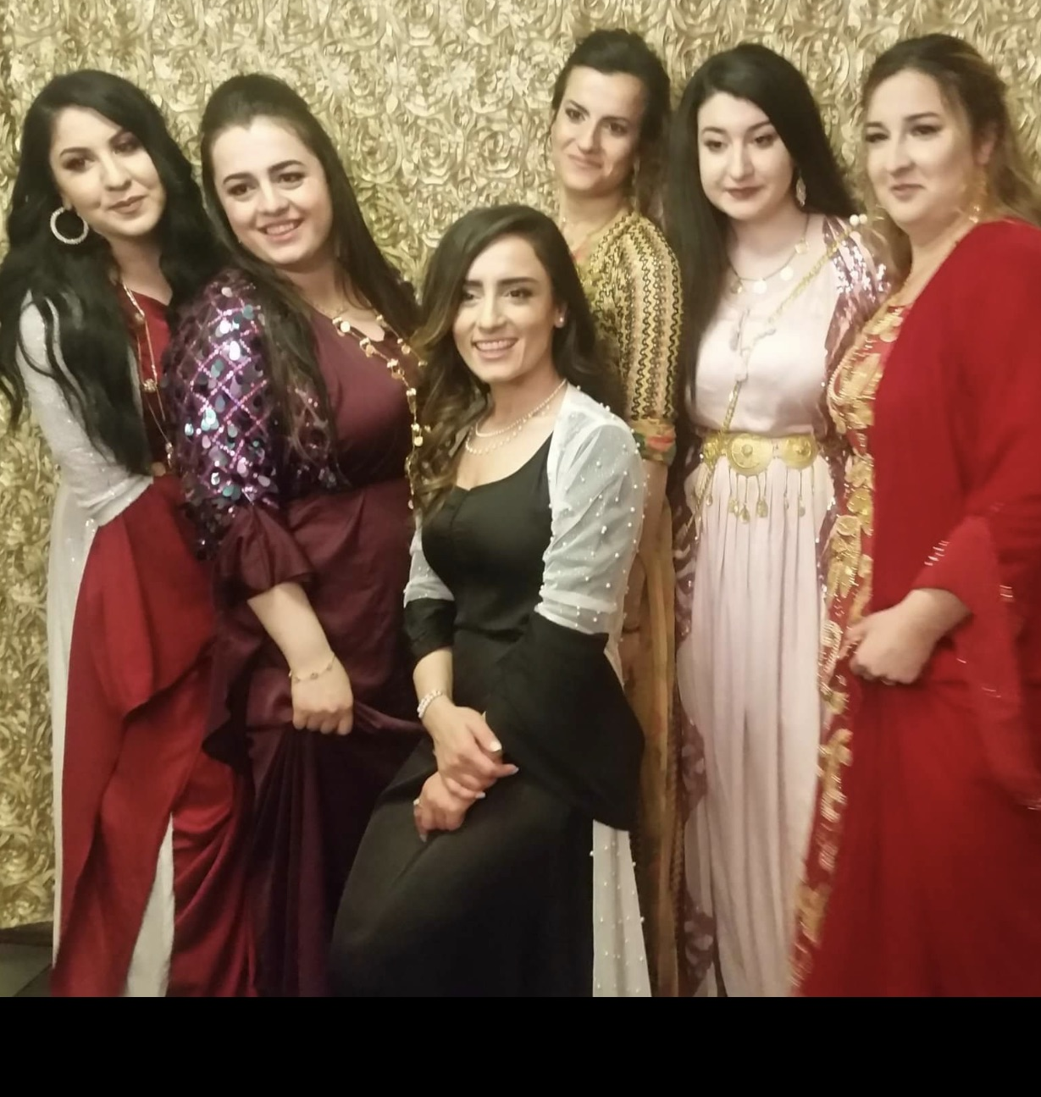
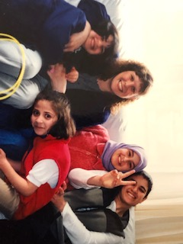
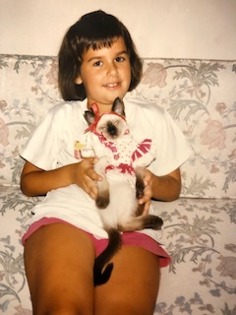
*Suggestion New Refugees and Asylees

Slide 32
What are you taking away from today? 1. Co-Reflection Supervision 2. Peer Customer Evaluations
Yay!

Slide 33
From my ohana to yours
How Could Anyone – Shaina Noll
How could any one ever tell you
you were anything less than beautiful?
How could anyone ever tell you
you were less than whole?
How could anyone fail to notice your loving is a miracle
How deeply your connected to my soul

Slide 34
How was you today? a 😸 b 💑 c 😭 d 😒 e please type in the chat
*

Slide 35
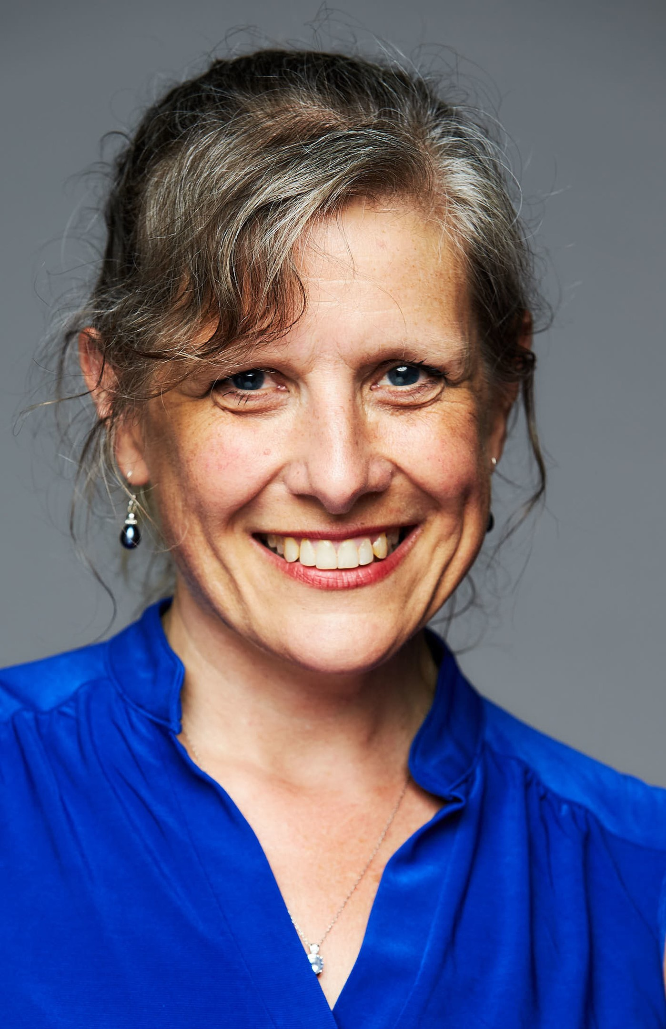
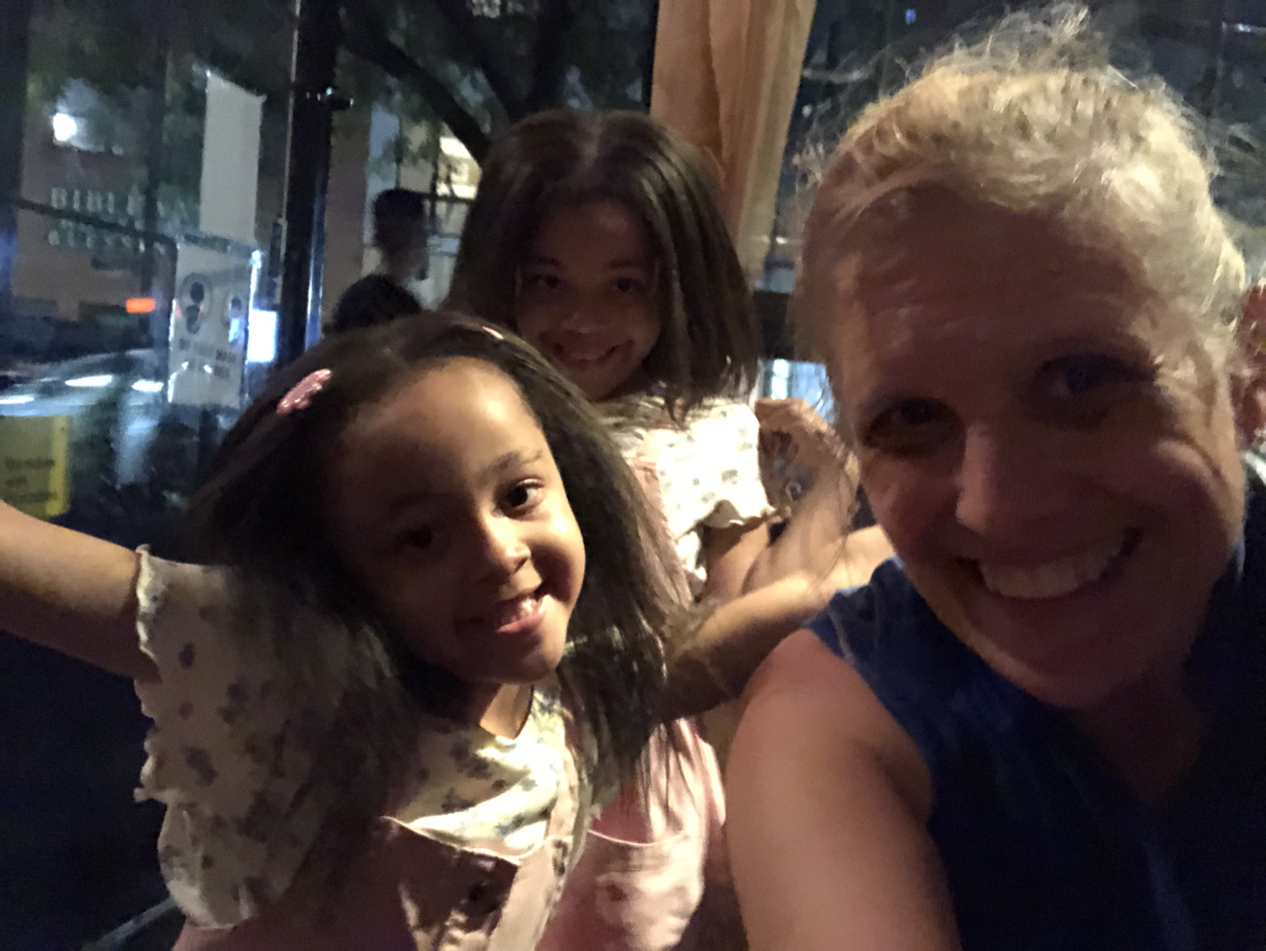
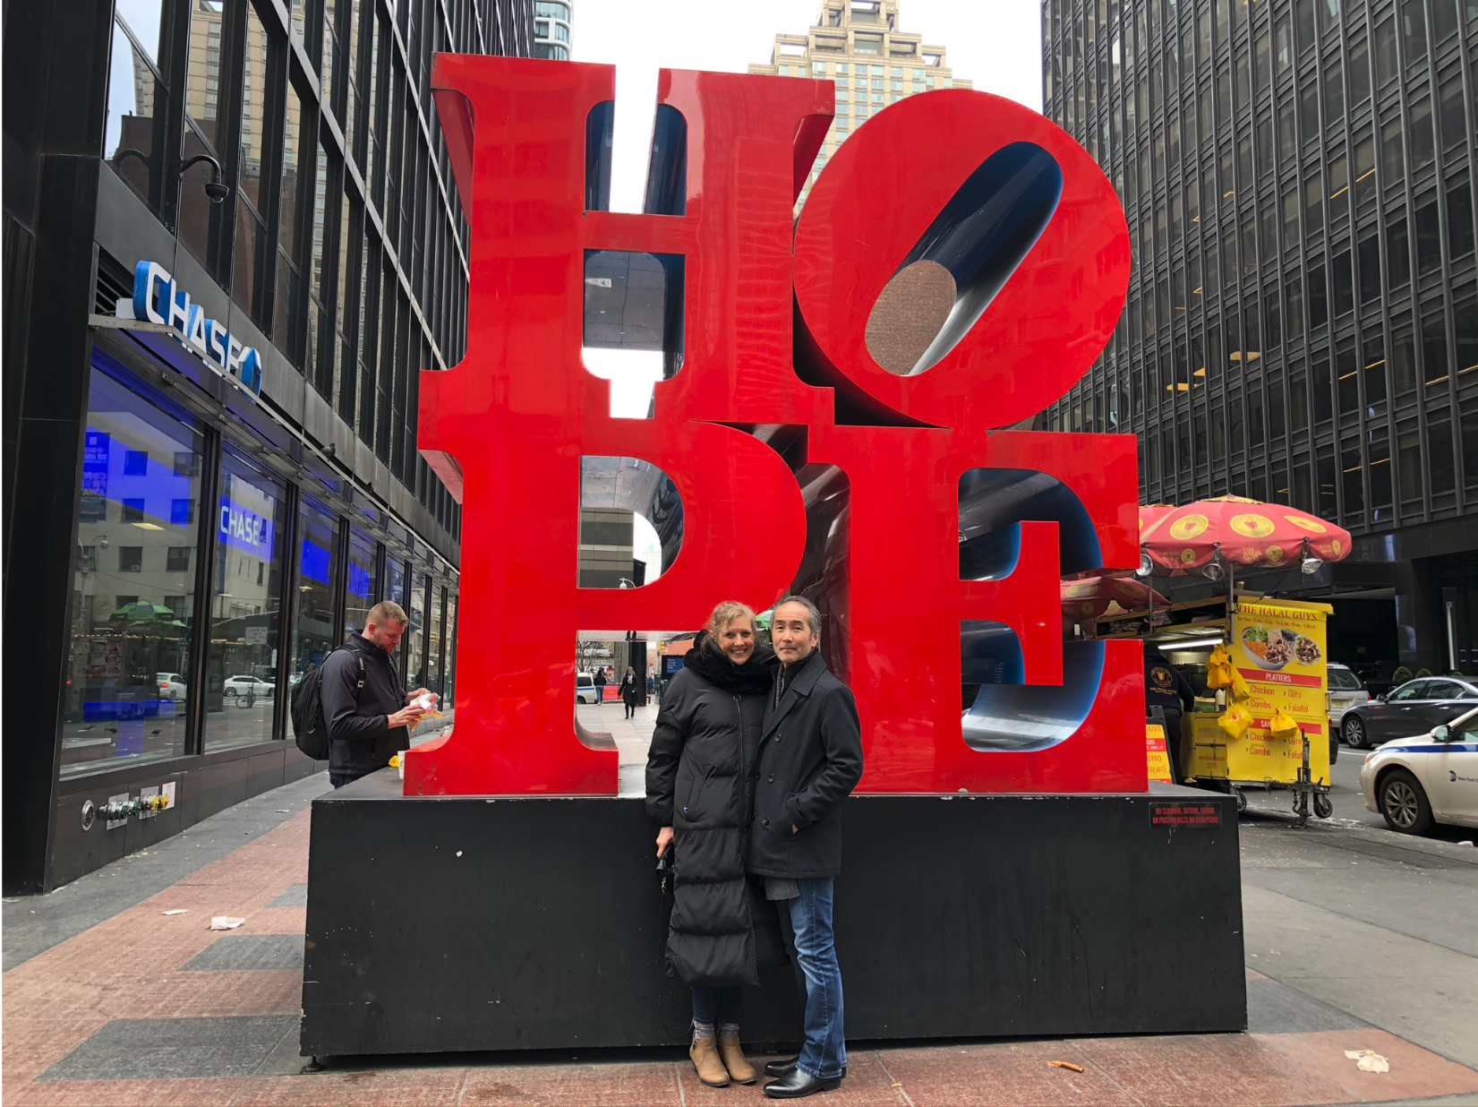
Thanks!
Any questions?
You can find me at
@annkasper
ann@empowermentroots.com
kasperconnects.com
www.vimeo.com/mentalhealthfreedom
Presentation template by SlidesCarnival

