Slide 1
Listening to the Voice of the Peer
You Don’t Know What You Think You Know About a Veteran

Slide 2
Listening to the Voice of the Peer “You Don’t Know What You Think You Know About a Veteran”
Dr. Kathy Cash
Presenter
CEO/Founder, Strategies 4 Hope
Pastor, Determined to Know Christ Ministries
U.S. Army Veteran * Certified Peer Specialist

Slide 3
Disclaimer: I AM NOT AN EXPERT ON VETERANS We are different but we have similar experiences.

Slide 4
Objectives:
Identify
Identify the unique role of Peers in the Veteran community
Explore
Explore the role of the Supervisor of a Peer
Address
Address Peer Drift
Define
Define ways the Supervisor can provide support to the Peer

Slide 5
What does a Veteran look like?

Slide 6
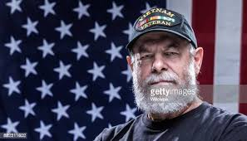
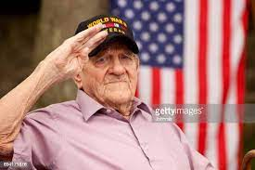
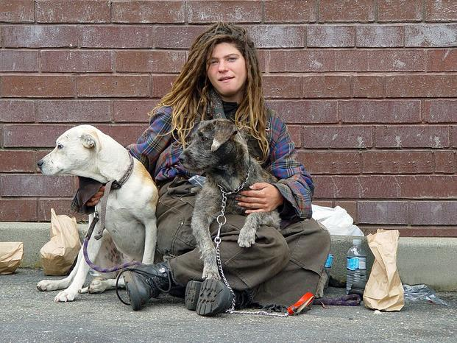
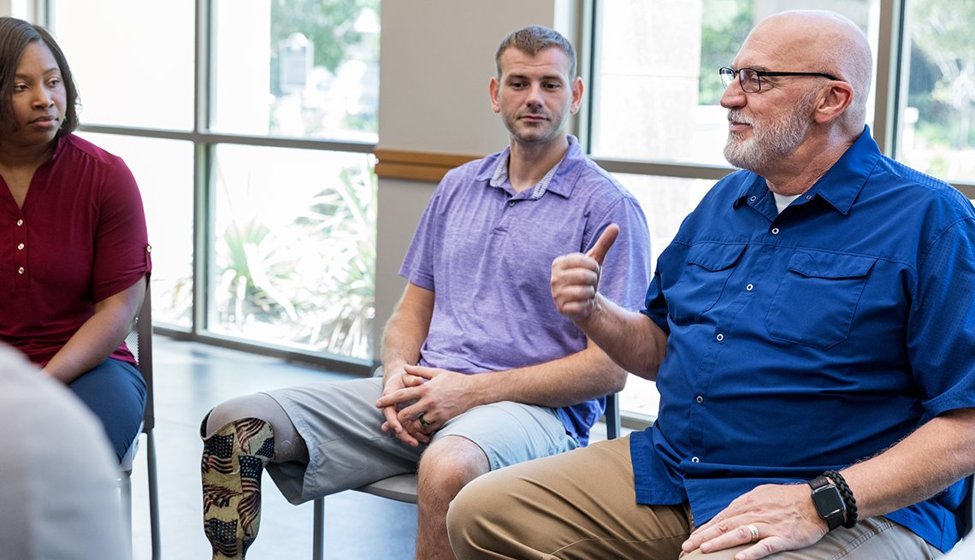
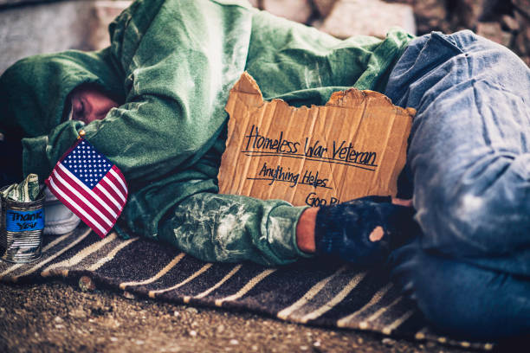
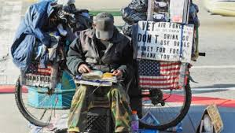
Veterans in our country

Slide 7
What does a Veteran who is now a Peer look like now and/or before becoming a Peer?

Slide 8
Veterans who are now Peers

Slide 9
What makes a Peer who is a Veteran unique? (Please put your comments in the chat)

Slide 10
How do you find out those unique qualities or characteristics of Peers who are Veterans supporting Veterans?
Talk to the Peer
Talk to another Peer
Talk to another Peer!

Slide 11
What is the role of the Supervisor of a Peer who supports Veterans?
Implement a professional relationship to help the Peer utilize their unique skills and knowledge in supporting fellow Veterans
Encourage continued learning and skill development
Provide regular and constructive feedback
Support the service that the Peer provides

Slide 12
Addressing Peer Drift
What is Peer Drift?
A confusion in the role of the Peer
What causes Peer Drift?
A shift or misunderstanding in the identification of the role of the Peer or in the Peer’s boundaries

Slide 13
What are ways to reduce Peer Drift? (Please put your comments in the chat)

Slide 14
Some ways to reduce Peer Drift
Peer Certification
1
Discuss the Peer certification requirements and competencies
Recovery
2
Discuss how to maintain the Peer role that is recovery-oriented
Boundaries
3
Discuss the Peer boundaries and ethics
Uniqueness
4
Discuss what a Peer offers that is different from other disciplines

Slide 15
What ways can a supervisor provide support to the Peer? (Please put your comments in the chat)
Communicate (to include listening) in an open-minded capacity to the challenges encountered by Peer.
Provide opportunity for Peer to discuss recovery-oriented options with interdisciplinary team members.
Encourage Peer to identify strengths and abilities. This will aid Peer in facilitating innovative methods for engaging Veterans.
Provide training for staff about the non-clinical role of the Peer.

Slide 16
Conclusion
Identified
Identified the unique role of Peers in the Veteran community
Explored
Explored the role of the Supervisor of a Peer
Addressed
Addressed Peer Drift
Defined
Defined ways the Supervisor can provide support to the Peer

Slide 17
QUESTIONS?

Slide 18
THANK YOU FOR BEING HERE I am Dr. Kathy Cash Strategies 4 Hope Where Hope is nurtured and cultivated through support! info@strategies4hope.com LinkedIn https://www.linkedin.com/in/dr-kathy-cash Podcast https://anchor.fm/dr-kathy-cash

